Slide 1
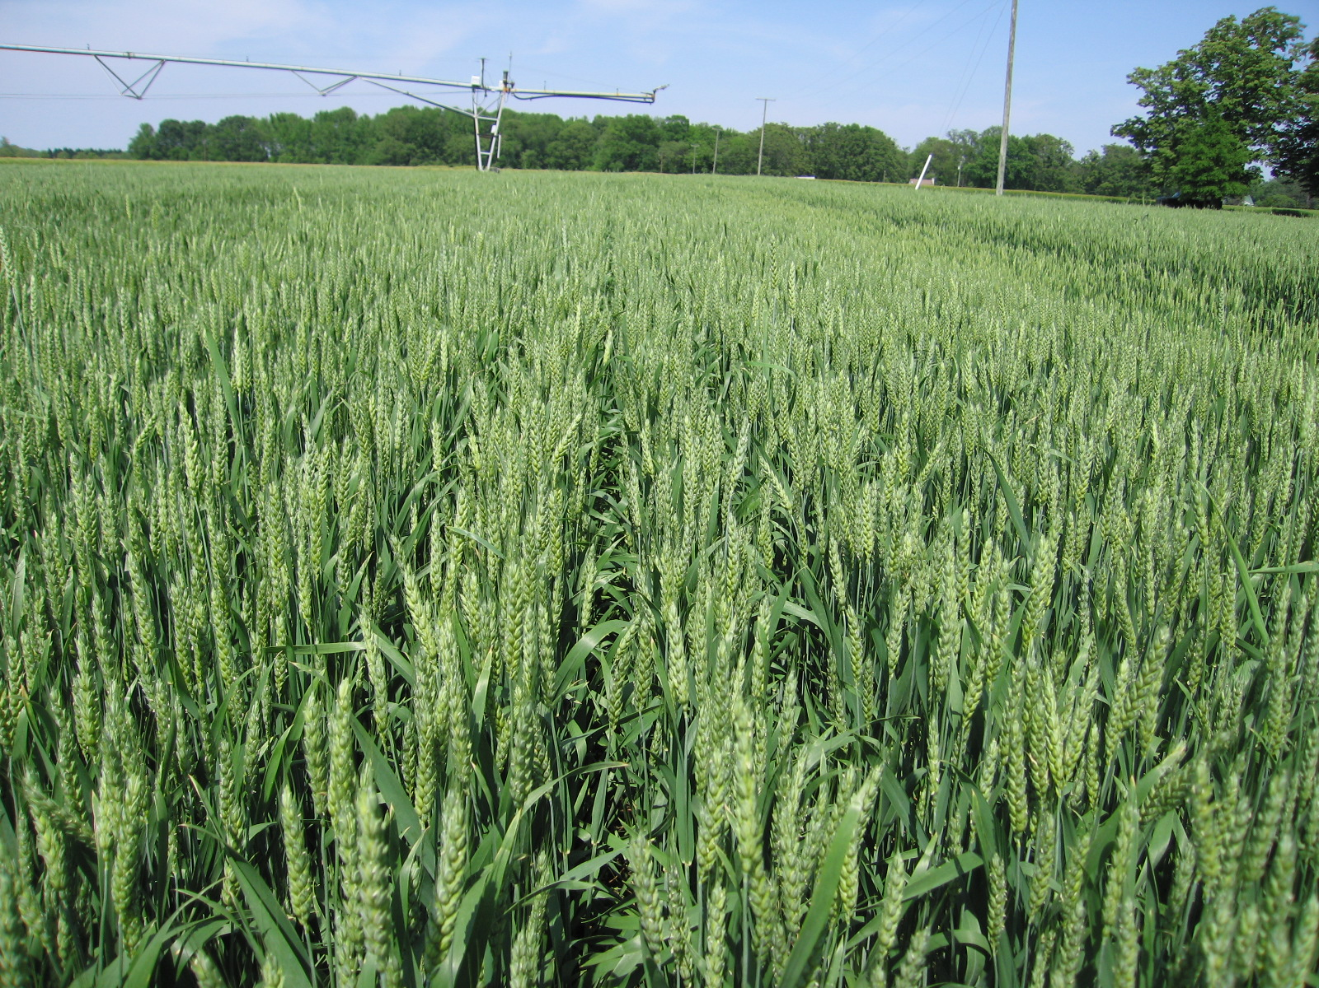
Wheat and Barley Management
Wade Thomason
Virginia Tech Extension Grains Specialist
12/13/10

Slide 2
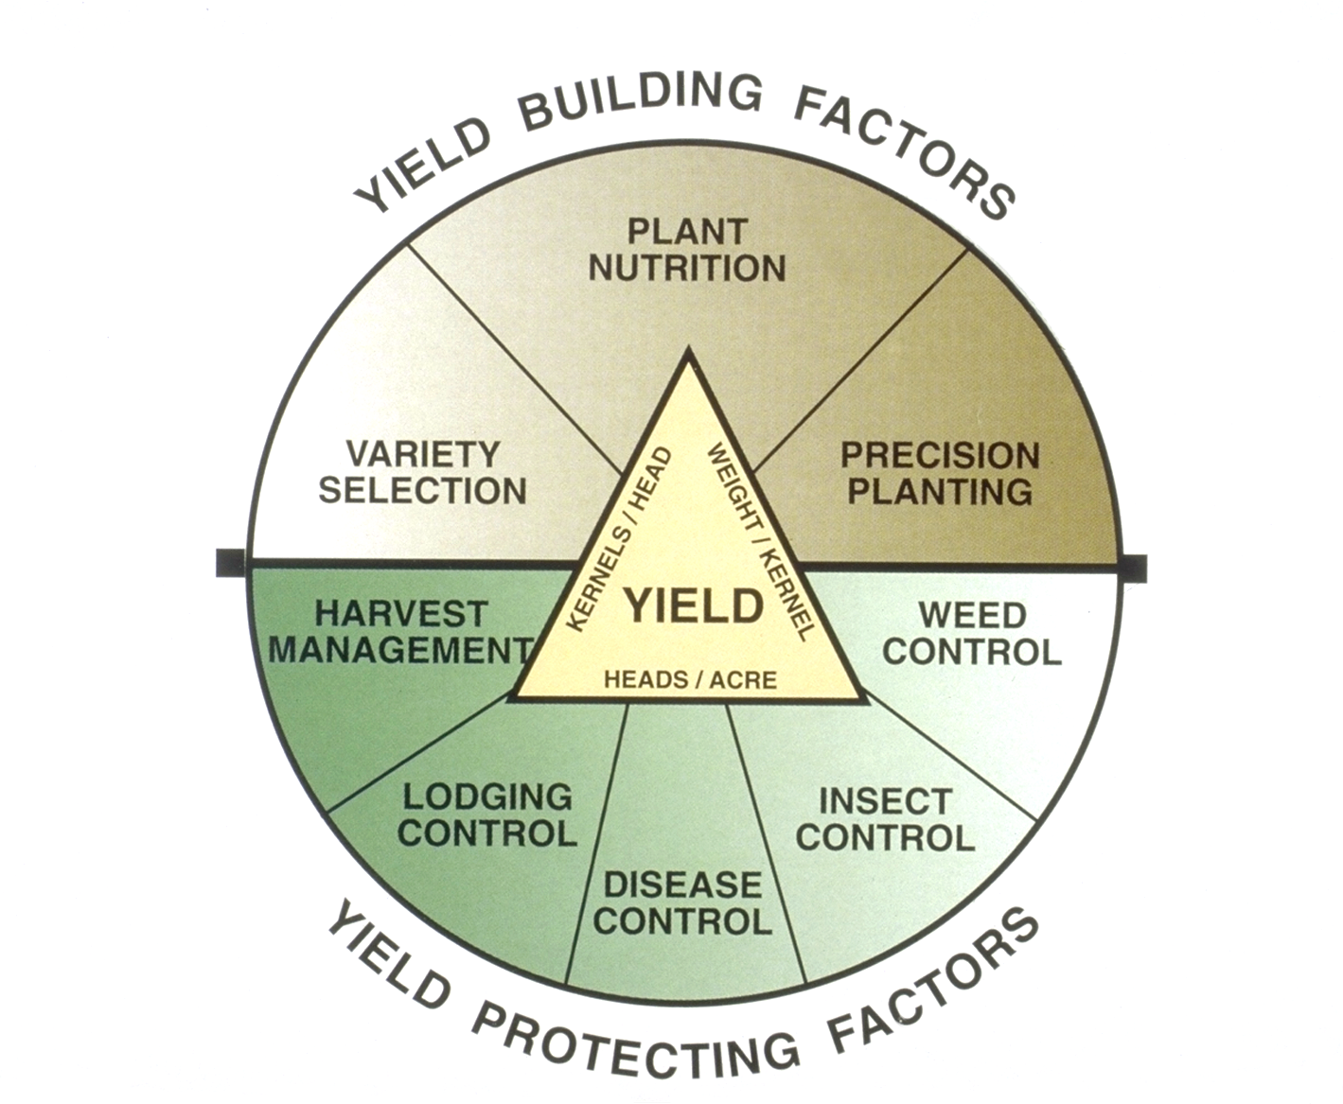
Notes:
Final crop yield at a specific site is a function of the combination of yield building factors: genetics, plant nutrition, and precision planting (the planting has been the major problem with reduced tillage situations) and yield protection factors. Nutrition is not the big problem with decreasing tillage; determining when to plant, obtaining needed plant populations, and working with disease and insect problems are the major challenges.

Slide 3
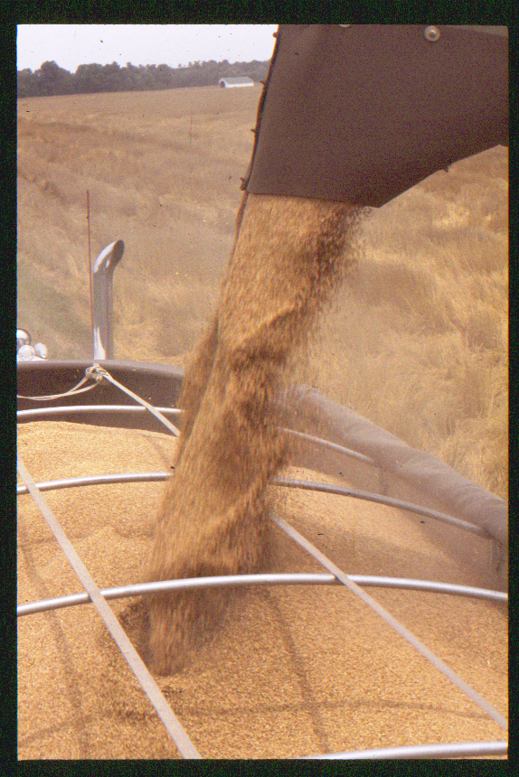
OVERALL GOALS
Efficient Production
  Frugal
  Cannot save our
  way into profitability
High Yields
  Cover fixed costs
  Enable profit

Slide 4
Planting to a population

Slide 5
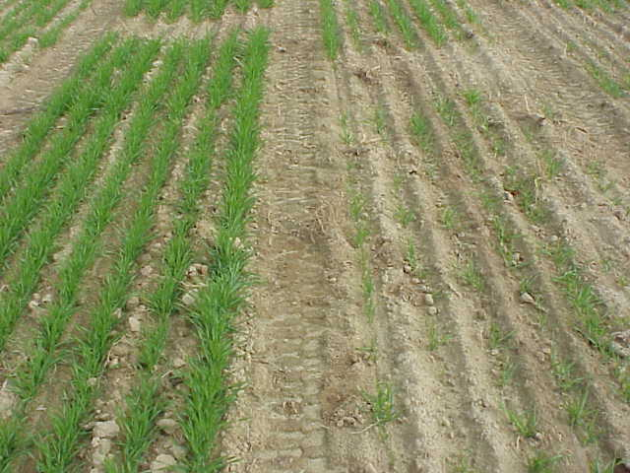
30 seeds/sq ft 10 seeds/sq ft

Slide 6
Yield Development- Precision Planting
Wheat
  Attain 22-25 vigorous seedlings / square ft.
  Calibrate the drill for 30-35 seeds /square ft.
 | Planting Time
Row width, in | Timely | 2 wk late | 4 wk late
 | Seeds/row foot
4 | 12 | 13 | 14
6 | 18 | 20 | 22
7 | 20 | 22 | 24
8 | 22 | 24 | 26
Notes:
Virginia research has determined the optimum seeding rate for the climate. Optimum yields occur with 60 heads per square foot at harvest time. Since over 80% of final grain yield comes from the main stem and first tiller, divide that 60 heads by 2 (one for the main stem and one for the tiller) to get the number of plants needed to reach that goal of 60.
So, the goal is to attain 22-25 viable seedlings per square foot. Because germination and emergence of all planted seeds is a very rare occurrence, seeding rates should be 30-35 seeds per square foot.
Seeding rate should be increase approximately 10% for every two weeks after the optimum planting date.

Slide 7
Yield Development- Precision Planting
Barley
  Attain 26-28 vigorous seedlings / square ft.
  Calibrate the drill for 30-35 seeds /square ft.
Notes:
Virginia research has determined the optimum seeding rate for the climate. Optimum yields occur with 60 heads per square foot at harvest time. Since over 80% of final grain yield comes from the main stem and first tiller, divide that 60 heads by 2 (one for the main stem and one for the tiller) to get the number of plants needed to reach that goal of 60.
So, the goal is to attain 22-25 viable seedlings per square foot. Because germination and emergence of all planted seeds is a very rare occurrence, seeding rates should be 30-35 seeds per square foot.
Seeding rate should be increase approximately 10% for every two weeks after the optimum planting date.

Slide 8
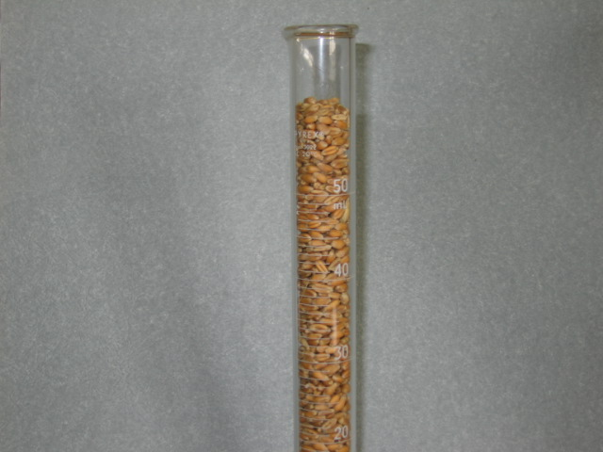
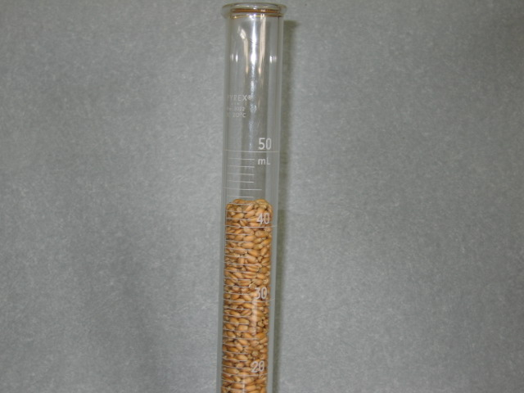
Seed Size
 | Seed per lb. Over Years and Varieties
 | 2008 | 2007 | 2006 | 2005 | 2004 | 2003 | 2002 | 2001 | 2000
COKER 9184 |  | 11182 | 12738 | 12898 | 13480 | 14856 | 13593 | 13512
PIONEER 26R24 | 16703 | 16249 | 12304 | 13121 | 12876 | 12682 | 12270 | 12473 | 13198
TRIBUTE | 15986 | 11629 | 12942 | 11762 | 13016 | 12486 | 12541 | 13353 | 16249
Notes:
Tribute 2007 to 2008 = 37% decrease in seed size
Tribute to 26R24 in 2007 ~ 40%
Tribute to 26R24 in 2008 ~ 4%

Slide 9
Seeding Rate
 | Desired plant population, seeds/sq ft
Seed size | 18 | 20 | 22 | 24 | 26 | 28 | 30 | 32 | 34 | 36
seeds/ lb | Seeding rate, lb/ac
10,000 | 87 | 97 | 106 | 116 | 126 | 136 | 145 | 155 | 165 | 174
11,000 | 79 | 88 | 97 | 106 | 114 | 123 | 132 | 141 | 150 | 158
12,000 | 73 | 81 | 89 | 97 | 105 | 113 | 121 | 129 | 137 | 145
13,000 | 67 | 74 | 82 | 89 | 97 | 104 | 112 | 119 | 127 | 134
14,000 | 62 | 69 | 76 | 83 | 90 | 97 | 104 | 111 | 118 | 124
15,000 | 58 | 65 | 71 | 77 | 64 | 90 | 97 | 103 | 110 | 116
16,000 | 54 | 61 | 67 | 73 | 79 | 85 | 91 | 97 | 103 | 109
17,000 | 51 | 57 | 63 | 69 | 74 | 80 | 85 | 91 | 97 | 102
18,000 | 48 | 54 | 59 | 65 | 70 | 75 | 81 | 86 | 91 | 97
19,000 | 46 | 51 | 56 | 61 | 66 | 71 | 76 | 82 | 87 | 92
20,000 | 44 | 48 | 53 | 58 | 63 | 68 | 73 | 77 | 82 | 87
Assumes 90% germination
Planting Wheat: Seeding Rates and Calibration
Notes:
It is important to plant on a seed per foot basis rather than on a weight per acre basis. Since wheat kernel size is known to vary by as much as 50% (12,000 - 18,000 seeds per lb.) between varieties and years, it’s easy to see how planting rates in terms of bushels per acre or lbs. per acre without consideration of the seed size could result in low populations that reduce yields or high populations that increase seed cost. Planting 2 bushels per acre of seed that has 12,000 seeds per lb. would result in a seeding rate of 33 seeds per square foot; conversely, planting 2 bushels per acre of seed that has 18,000 seeds per lb. would result in a seeding rate of 50 seeds per square foot. Big difference!
Differences in the number of seed per lb. exist because seed weight or kernel plumpness is determined primarily by the environment in which it is grown and by the degree of cleaning
See the article “Planting Wheat: Seeding Rates and Calibration” for information on drill calibration steps.

Slide 10
Barley Seeding Rate
 | -----------------Seeds/lb-----------------
Thoroughbred | 11866 | 11052 | 12493 | 10956 | 15548
Eve (Hulless) | 11848 | 11529 | 12087 | 12011 | 13512
Doyce (Hulless) | 15379 | 13969 | 14404 | 15338 | 16691
 | Desired plant population, seeds/sq ft
Seed size | 18 | 20 | 22 | 24 | 26 | 28 | 30 | 32 | 34 | 36
seeds/ lb | Seeding rate, lb/ac
10,000 | 87 | 97 | 106 | 116 | 126 | 136 | 145 | 155 | 165 | 174
11,000 | 79 | 88 | 97 | 106 | 114 | 123 | 132 | 141 | 150 | 158
12,000 | 73 | 81 | 89 | 97 | 105 | 113 | 121 | 129 | 137 | 145
13,000 | 67 | 74 | 82 | 89 | 97 | 104 | 112 | 119 | 127 | 134
14,000 | 62 | 69 | 76 | 83 | 90 | 97 | 104 | 111 | 118 | 124
15,000 | 58 | 65 | 71 | 77 | 64 | 90 | 97 | 103 | 110 | 116
16,000 | 54 | 61 | 67 | 73 | 79 | 85 | 91 | 97 | 103 | 109
17,000 | 51 | 57 | 63 | 69 | 74 | 80 | 85 | 91 | 97 | 102
18,000 | 48 | 54 | 59 | 65 | 70 | 75 | 81 | 86 | 91 | 97
19,000 | 46 | 51 | 56 | 61 | 66 | 71 | 76 | 82 | 87 | 92
20,000 | 44 | 48 | 53 | 58 | 63 | 68 | 73 | 77 | 82 | 87
Notes:
12,300 T bred
12,200 Eve
15,100 Doyce

Slide 11
Seeding Rate – Push and Push Back
Component | 50 bu/ac | 100 bu/ac | 150 bu/ac | 150 bu/ac
Heads per square foot | 40 | 60 | 75 | 85
Grains per head | 26 | 30 | 32 | 31
Seed size, g/1000 seed | 32 | 36 | 40 | 36

Slide 12
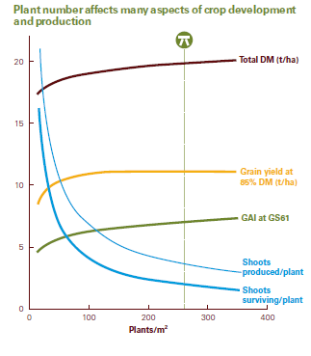
Seeding Rate – Push and Push Back

Slide 13
Wheat Seeding Depth
Seeding Depth (inches) | Stand Count (plants/ft²) | % Stand Achieved
0.5 | 27 | 77
1.0 – 1.5 | 26 | 74
2.5 – 3.0 | 12 | 34
Stand counts taken in mid-November.
Seeding rate of 35 seeds/ft².
Lee and Herbek © 2006 University of Kentucky
13

Slide 14
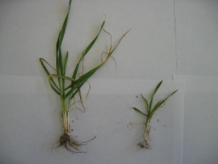
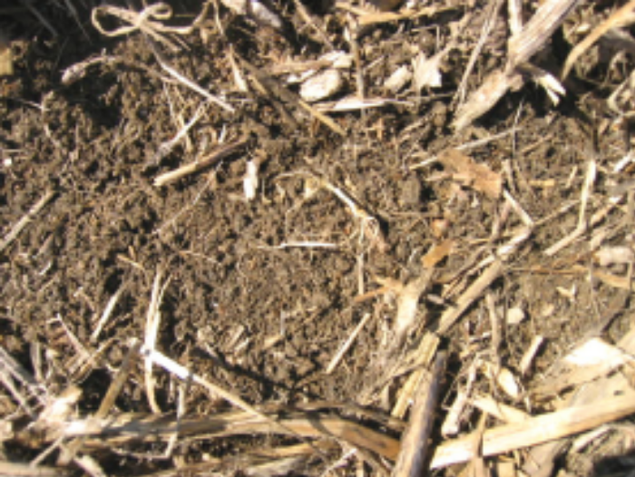

Slide 15
Estimated Yield Potential
% Stand | Plants/ft^{2*} | % Yield Potential**
100 | 30-35 | 100
80 | 24-28 | 100
60 | 18-21 | 90-95
50 | 15-18 | 75-80
40 | 12-14 | 60-70
20 | 6-7 | 40-50
* Multiply by 9 for plants/yard².
**This is an estimate and other factors can alter these estimates.
Lee and Herbek © 2006 University of Kentucky
15

Slide 16
Planting Method
85
Broadcast
80
Drilled
75
Grain Yield, bu/ac
70
65
60
0
45
89
134
179
Seeding Rate, lb/ac

Slide 17
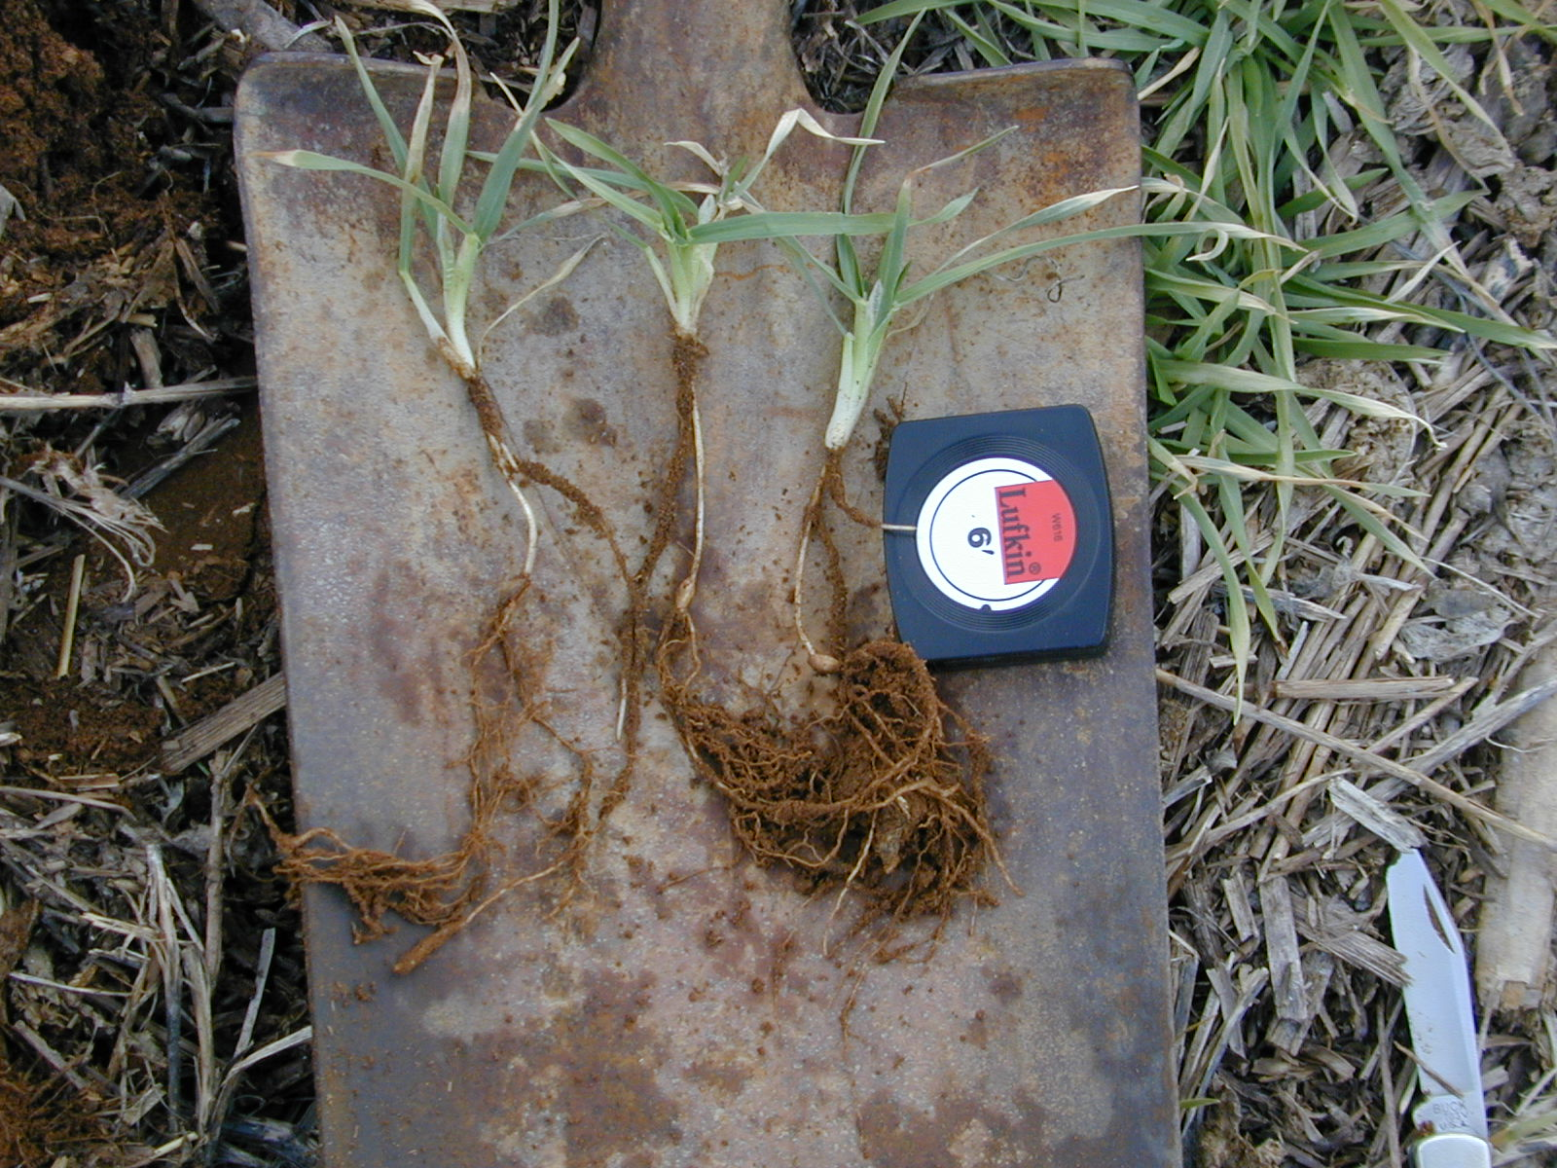

Slide 18
Small Grains
Tillers developed in the fall or winter produce larger numbers of wheat kernels per head than tillers developed in the spring.
Fall/winter developed tillers also have deeper root systems that give greater protection against dry weather during grain fill in May or early June

Slide 19
Late Planted Wheat
90
80
70
60
50
Yield Potential, bu/ac
40
30
20
10
0
15-Oct
25-Oct
04-Nov
14-Nov
24-Nov
04-Dec
14-Dec
24-Dec
03-Jan
Simulated Planting Date

Slide 20
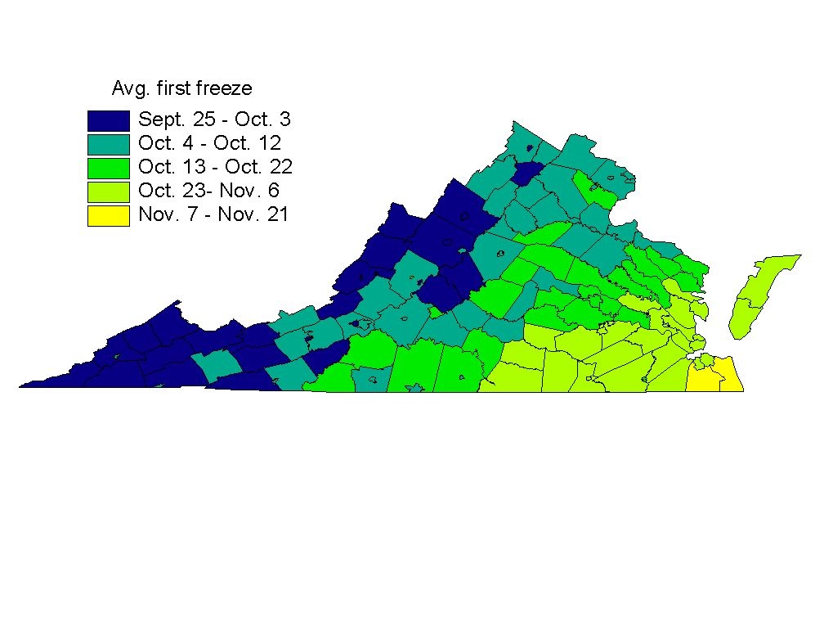

Slide 21
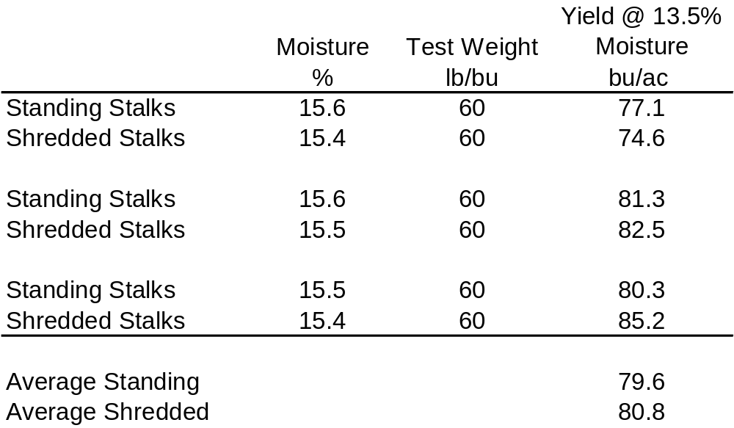
Middlesex Co, 2007
Planted 11/02/06
SS 520

Slide 22
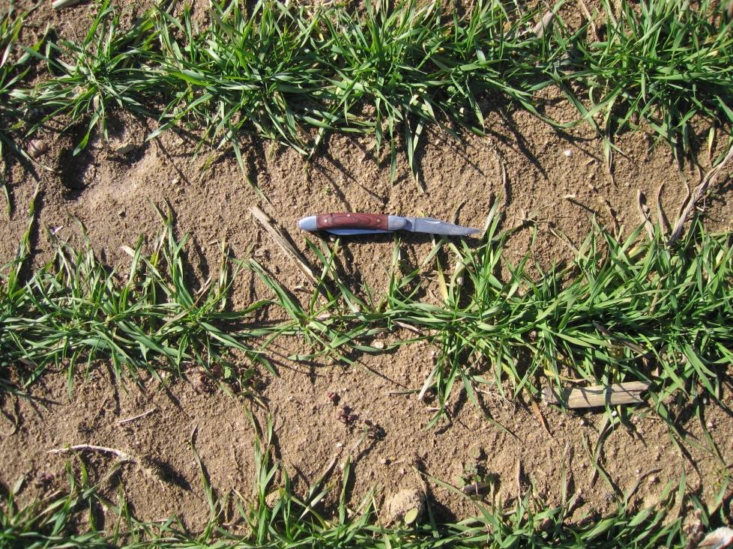
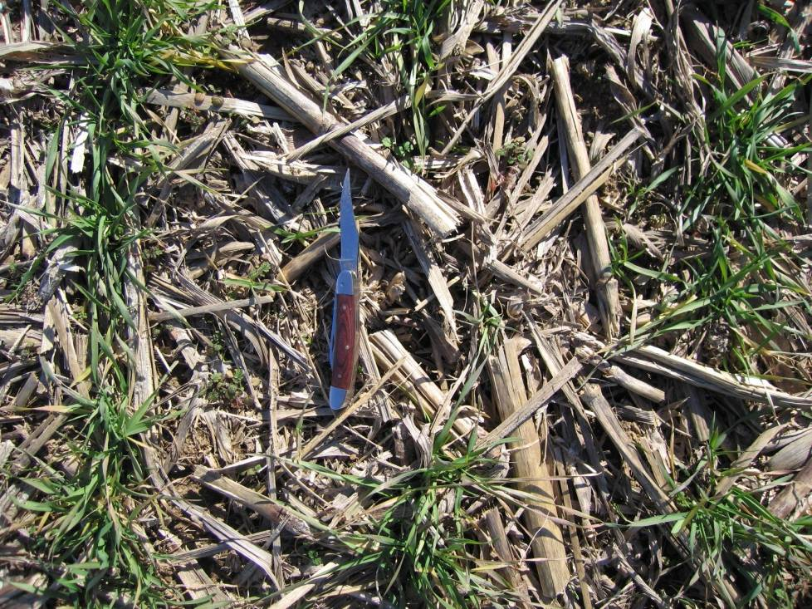
What about No-Till and Fall Growth?

Slide 23
2008-2009 Fall/Winter Growth

Slide 24
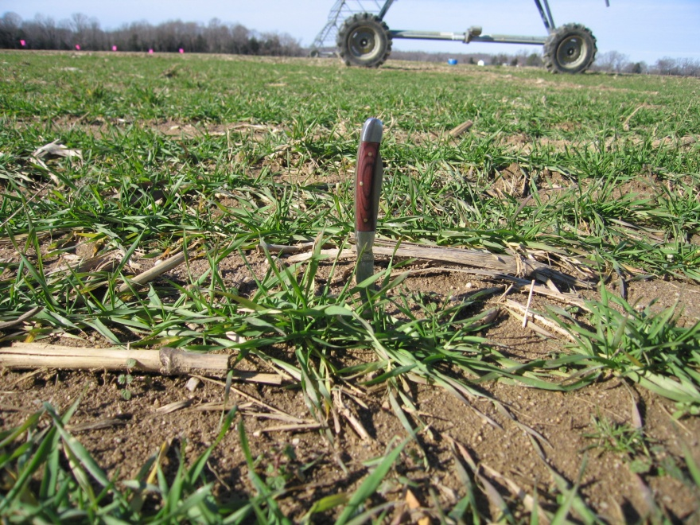
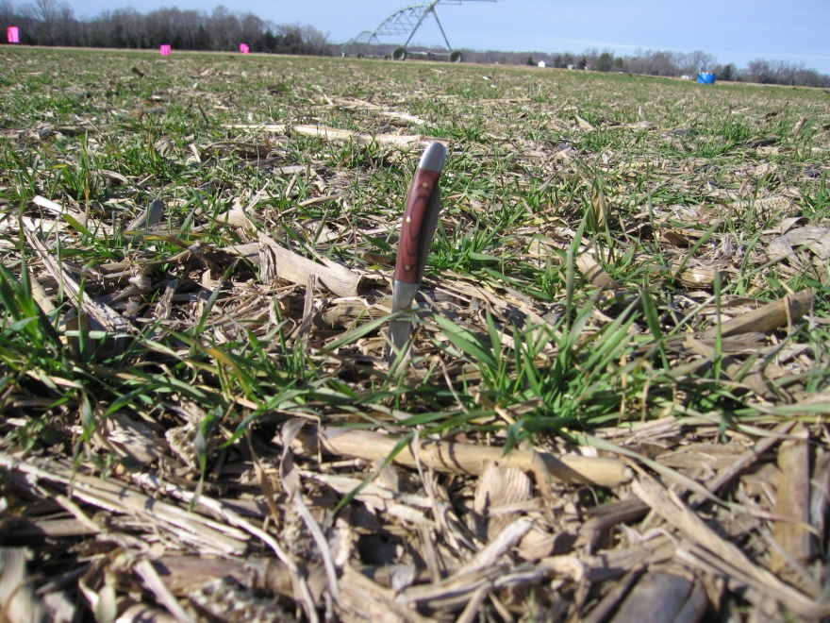
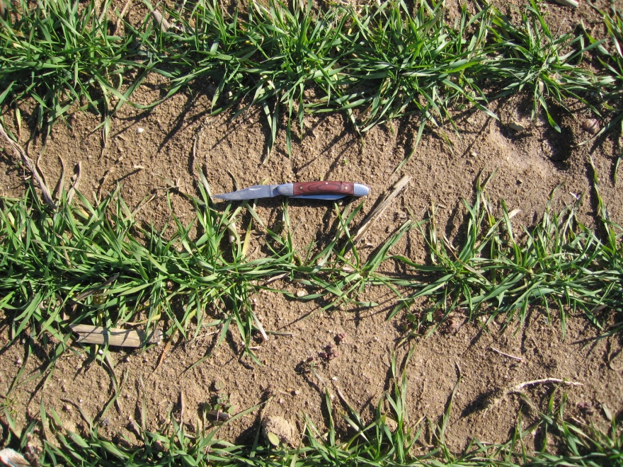
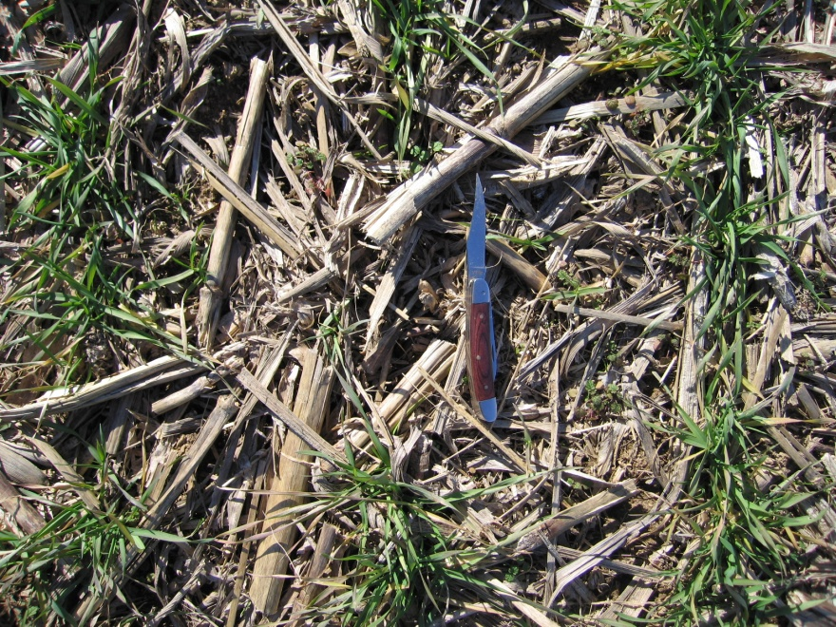

Slide 25
Wheat Growth Stages

Slide 26
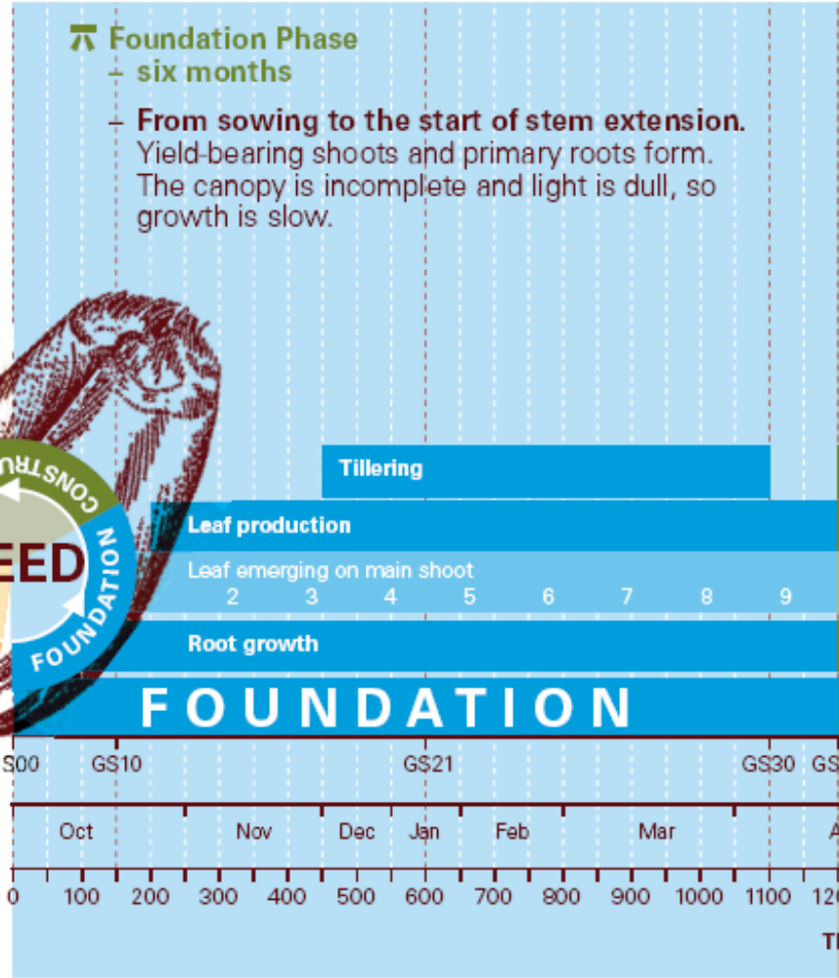
Foundation Phase of Wheat Growth
Sowing to stem
extension
Yield bearing
shoots
Primary roots
Length of Foundation Phase Varies with Environment

Slide 27
Planting Date Impacts Fall Growth
Virginia Coastal Plain 2006
2500
2
2000
y = 0.1762x
- 13898x + 3E+08
2
R
= 0.9999
1500
Total Biomass, lb/ac
1000
500
0
1-Sep
8-Sep
15-Sep
22-Sep
29-Sep
6-Oct
13-Oct
20-Oct
27-Oct
3-Nov
10-Nov
17-Nov
24-Nov
1-Dec
8-Dec
15-Dec
Notes:
Lb/GDD calculated from Paul’s plots in 2006, early and mid dates, rye, oats, barley.
Average GDD accumulation average of West Point and Warsaw, 1971-2000.

Slide 28
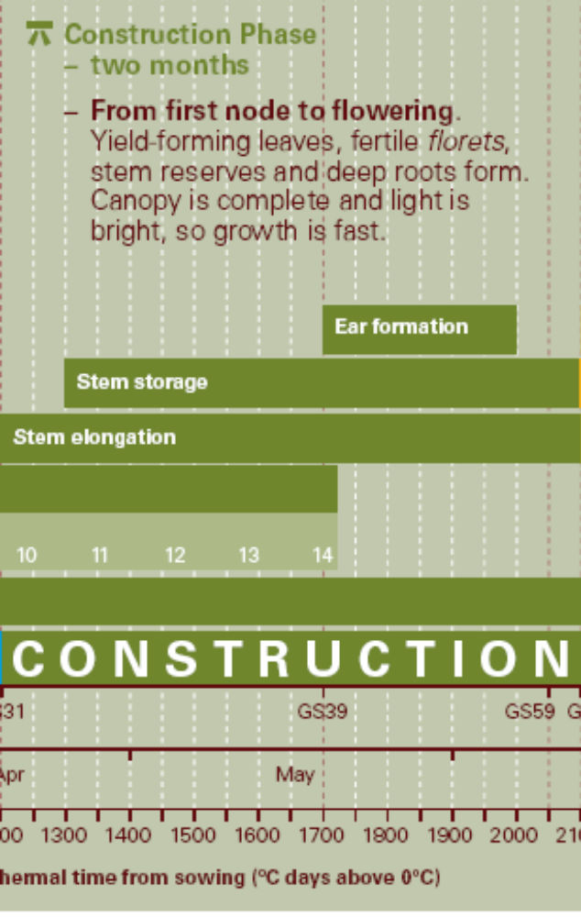
Wheat Yield Construction Phase
First node to flowering
Stem elongation
Stem storage
Ear formation
Yield forming leaves
Fertile florets
Stem reserves
Root growth
Canopy is complete

Slide 29
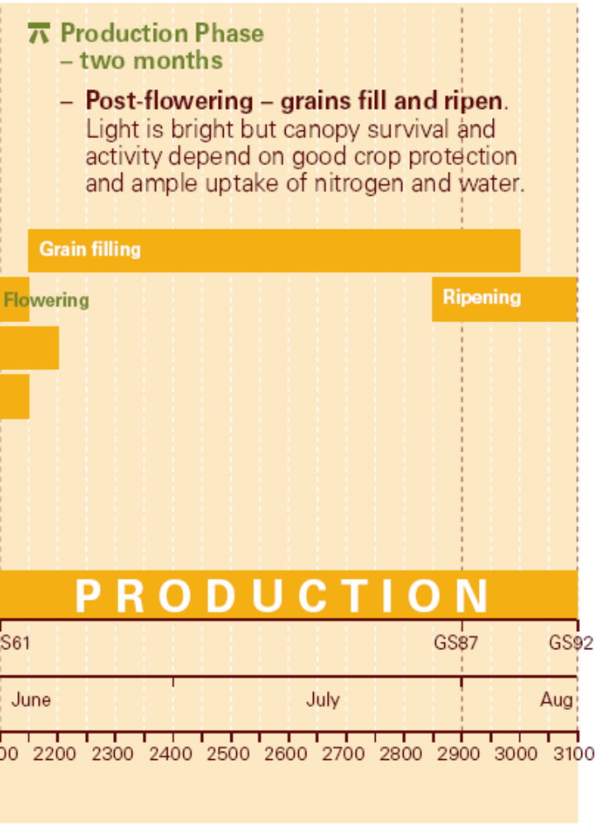
Wheat Yield Production Phase
Grain Filling
Green Leaf Area Critical
Remobilization of
carbohydrates and
proteins from stems and
leaves to grains
Duration of period
governed by climate and
management

Slide 30
Nitrogen Assessment and Management in Wheat Growth
At planting N needs
  Establish roots and initiate tillers
  Main stem and first tillers make the majority of the yield.
  Excessive fall growth increases disease and lodging susceptibility
  Excessive tillering in semi-arid environments can result in crop canopies that uses all available water prior to filling grain, or requires greater irrigation water.

Slide 31
Contribution of Tillers to Yield
Main
stem
Spring Wheat
Embden, ND – 3.1 t/ha
Second
tiller
T2
60
First
tiller
T1
50
40
Percent of final yield
30
20
10
0
Main stem
T1 + T2
Other
Goos and Johnson, 1996
Notes:
Studies were conducted in North Dakota to determine the contributions of various tillers to final yield.
At low yield levels (less than 20 bu/A), the main stem provides most if not all of the yield. However, at higher yields, the main stem provides about half of the yield and the T1 and T2 tillers in combination produce the remaining half. At very high yields, the contributions of other tillers, such as T3, T10, and T20, are not known.
Source:
Goos, R.J. and B.E. Johnson. 1996. Fertilizers and the early growth of spring wheat – agronomic and research implications. p. 259-268. In J.L. Havlin (ed.) Great Plains Soil Fert. Conf. Proc., Vol. 6., Denver, CO. 5-6 March 1996. Potash & Phosphate Inst., Norcross, GA.

Slide 32
Winter Wheat Plant Population For Virginia, USA Conditions
~30 plants/ft² with a minimum of 2 fall tillers established
Goal is a harvest population of 60 to 70 heads/ft² comprised of main stem and fall established tillers.
Achieved with proper planting dates that provide adequate growing degree days AND ADEQUATE NUTRITION AND WATER AVAILABILITY.

Slide 33
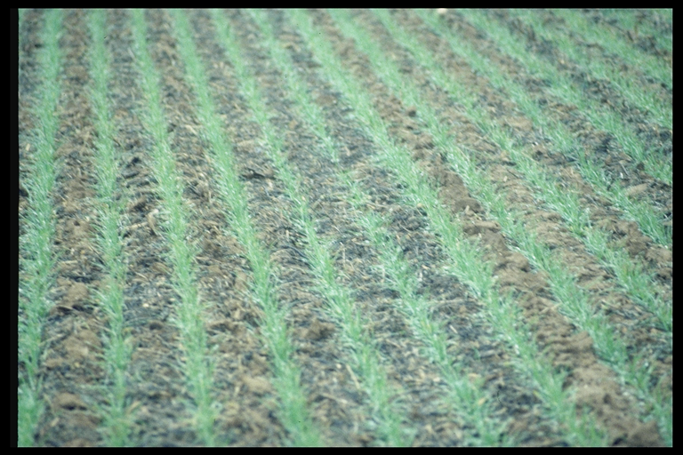
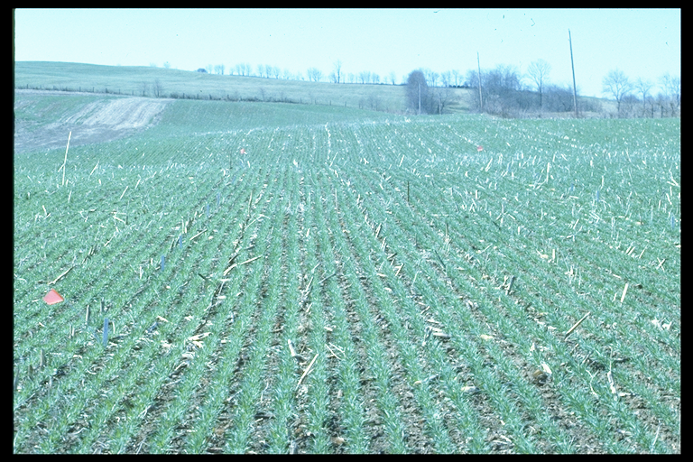
At-Planting
15 to 40 lb N/ac
P, K – Soil Test
Lime – Soil pH (water) 6.2
Establish vigorous, uniform plants
No additional P and K
after planting
N and S major remaining
nutrients to manage
Limited Mn and Cu
needs, foliar applications

Slide 34
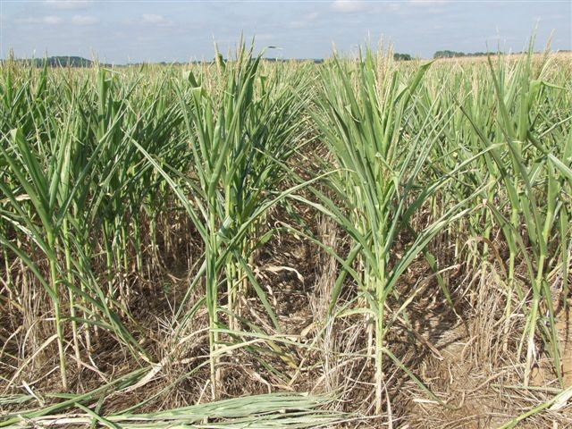
Residual Soil Nitrate Levels High Following
Drought Reduced Corn Yields

Slide 35
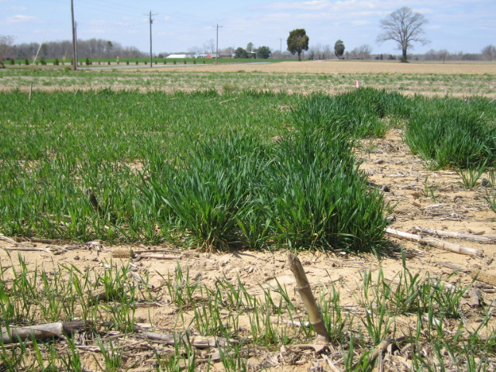
Excessive N At Planting

Slide 36
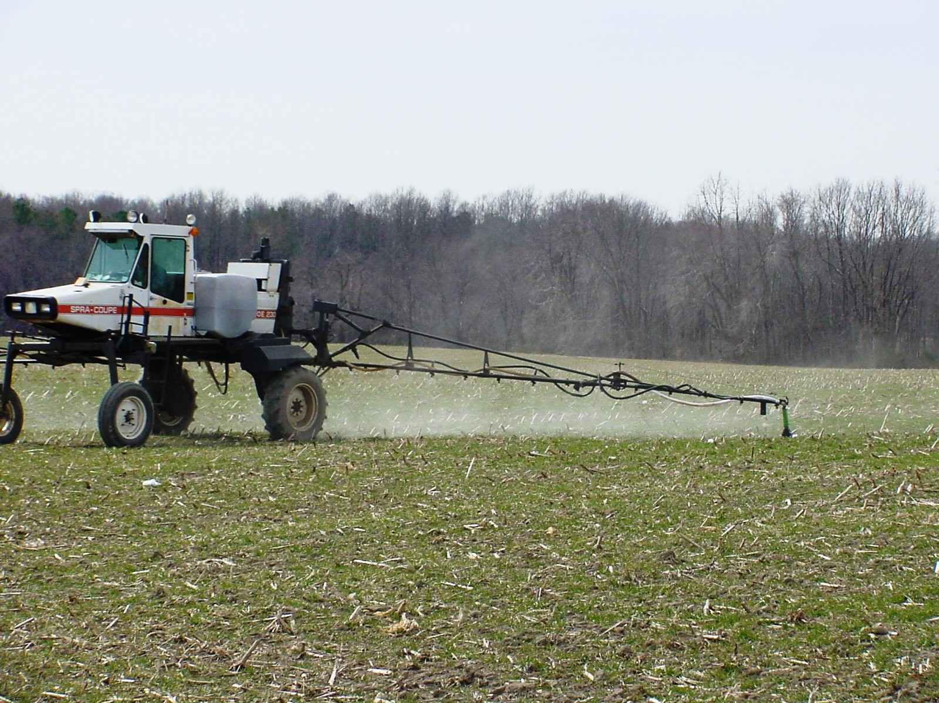
Split N Applications
Increase N Use Efficiency
N Rates Adjusted As Season Progresses
Urea-ammonium nitrate solution (UAN) with herbicide in December to
promote tiller development in No-till wheat system.
Goal is the main stem and two fall tillers established prior to winter
dormancy.

Slide 37
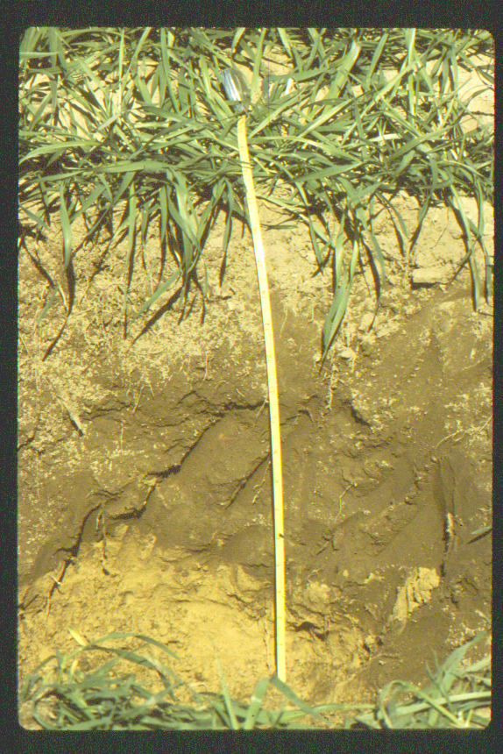
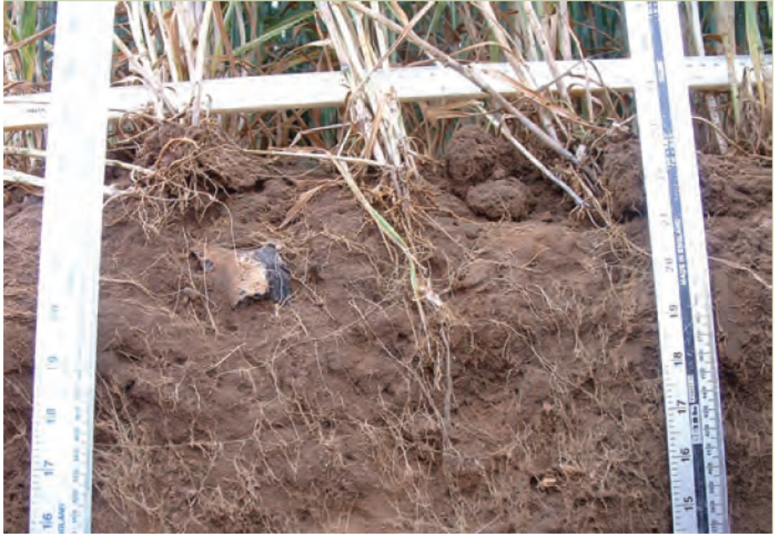
Root System Development Begins in Autumn
Larger Root Systems Increase Water and Nutrient Uptake

Slide 38
Tillage Effects on Wheat Yields
CT = +3 bu/ac (3.6%)

Slide 39
Pre-plant and Early Winter N Management, 2010 example
“Thanksgiving” N application?
~10-20% increase

Slide 40
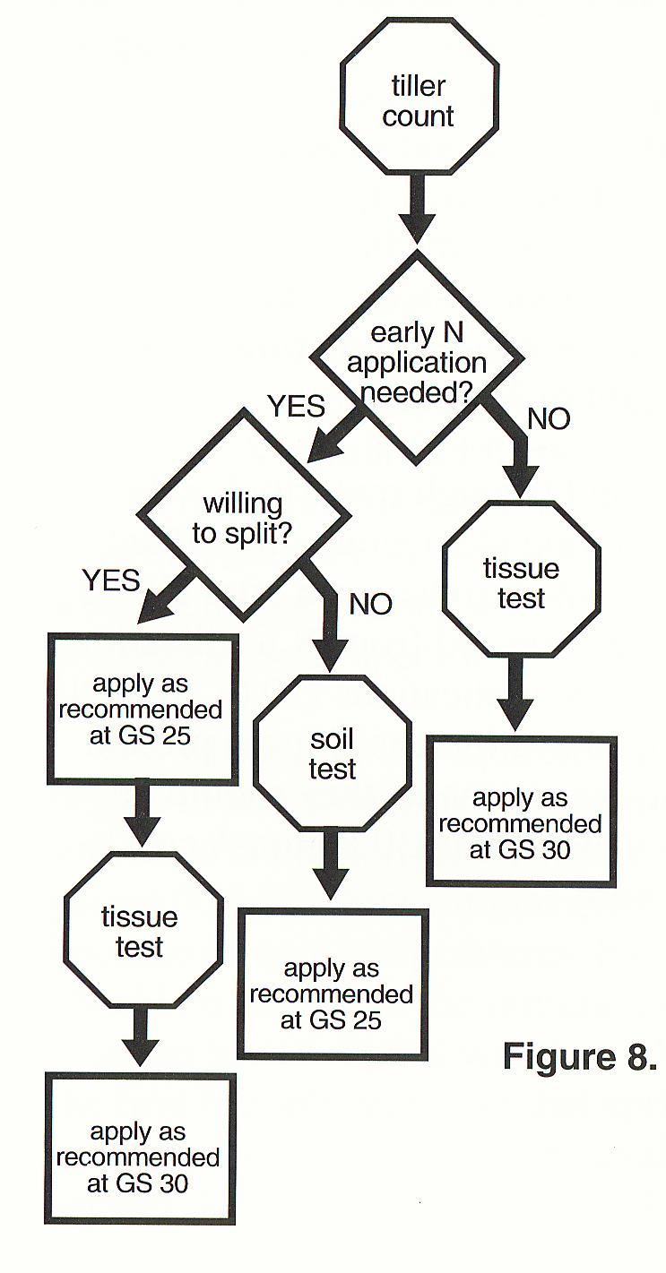
Flow Chart for the Process of Making Field Specific N Rate Recommendations for Late-winter, Early- spring N Applications for Winter Wheat

Slide 41
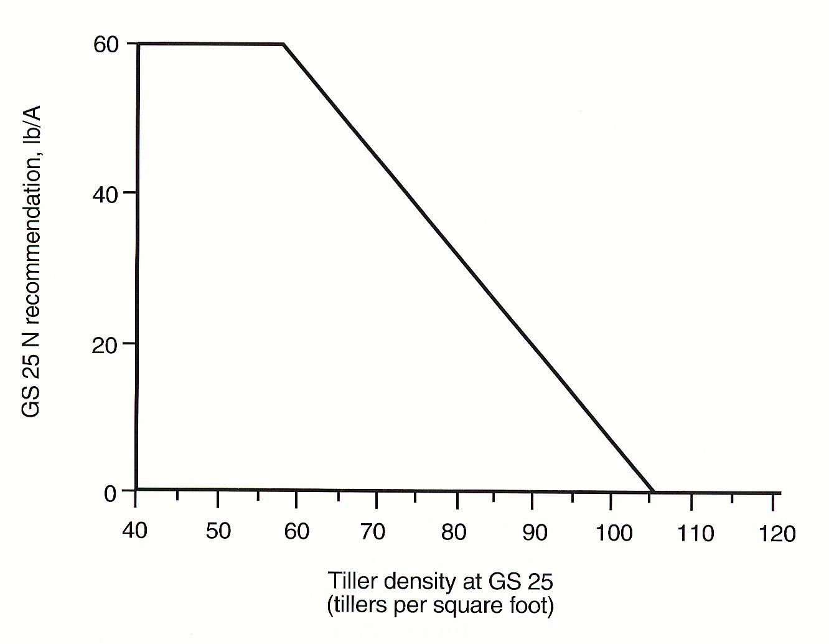
GS 25 N Rate
Directly Related to Tiller Numbers

Slide 42
Flow Chart for the Process of Making Field Specific N Rate Recommendations for Late-winter, Early- spring N Applications for Soft Red Winter Wheat

Slide 43
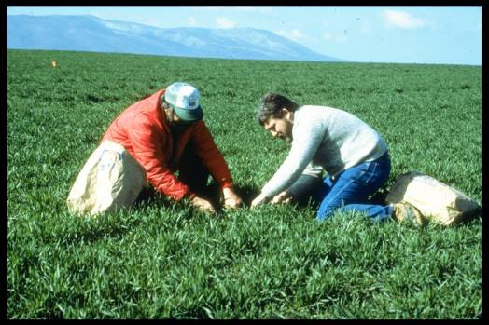
Tissue Sample at GS 30:
N Applications 0 to 80 lb N/ac
Do we sample all fields?

Slide 44
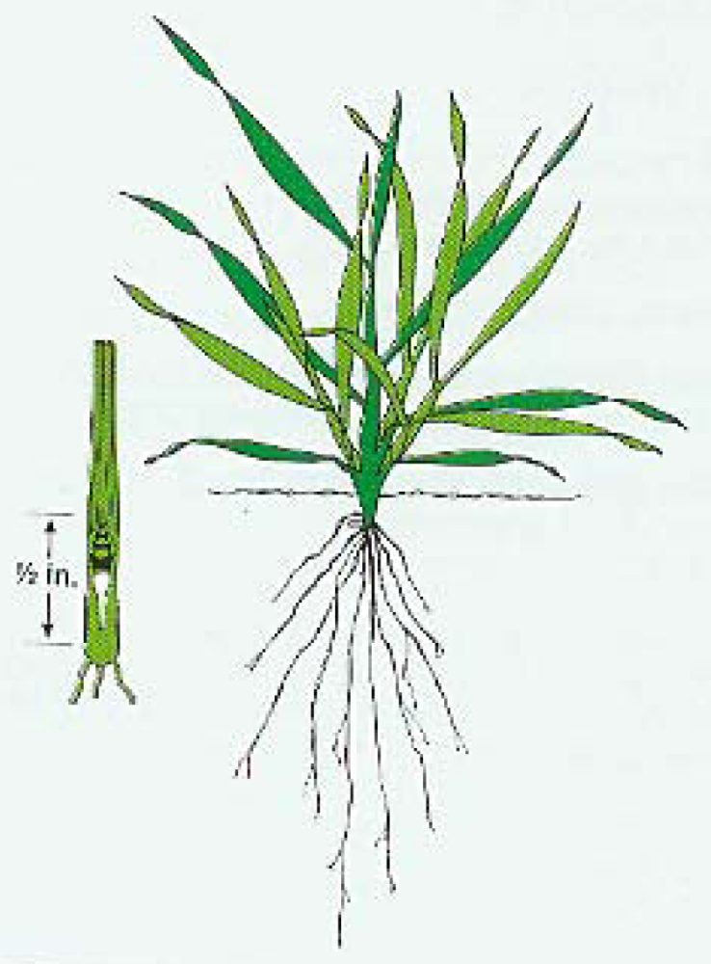
Wheat at Zadoks Growth Stage 30

Slide 45
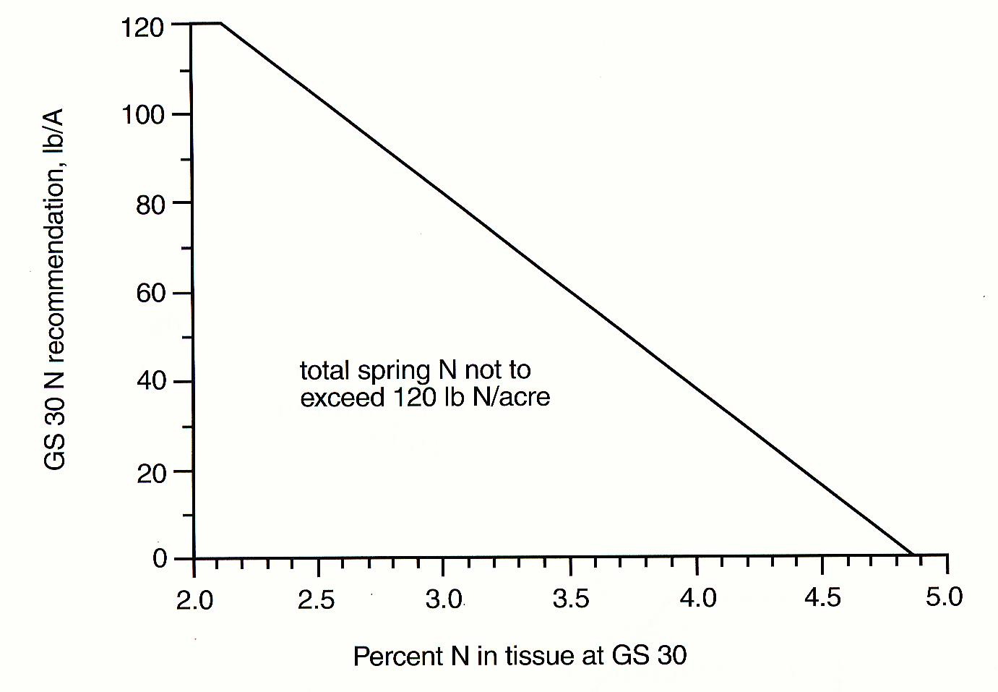
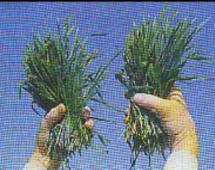
GS 30 N Application
Directly Related to Tissue N Content

Slide 46
Nutrient Sufficiency Levels for Whole Plant Wheat Tissue Samples at GS 30
Sufficient Level | Nutrient
 | P | K | Mg | S*
 | --------------------%------------------------
 | 0.25 | 2.0 | 0.10 | 0.25
*N/S ratio of ,15 indicates adequate S content relative to N content of tissue.

Slide 47
Nutrient Sufficiency Levels for Whole Plant Wheat Tissue Samples at GS 30
Sufficient Level | Nutrient
 | B | Zn | Mn | Cu
 | ---------------------mg/kg--------------------
 | 3 | 12 | 20 | 3

Slide 48
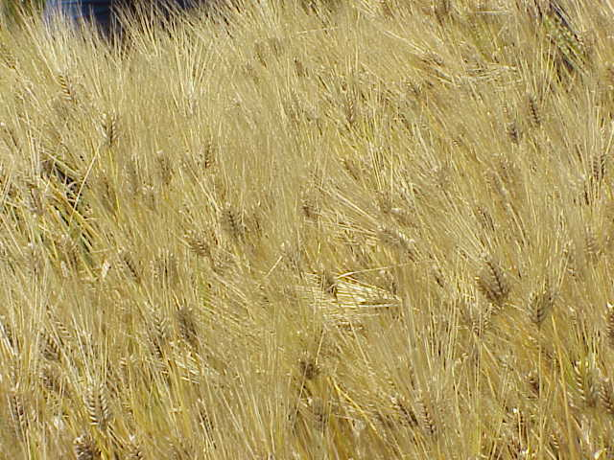
Spring N for Barley
GS 25 N Application
Apply 0-50 lbs N/acre based on field observations of tiller density and plant color.
Fields with tiller densities of greater than 150 tillers/sq ft should receive no N
Fields with densities of <50 tillers/sq ft should receive 50 lbs N/acre as soon as possible.
Do not wait for GS 30 to take tissue samples if the crop displays visual N deficiency symptoms prior to GS 30.

Slide 49
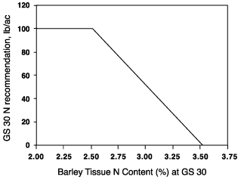
Spring N for Barley
GS 30 N Application
Directly Related to Tissue N Content
total spring N applications generally not to exceed 100 lbs N/acre

Slide 50
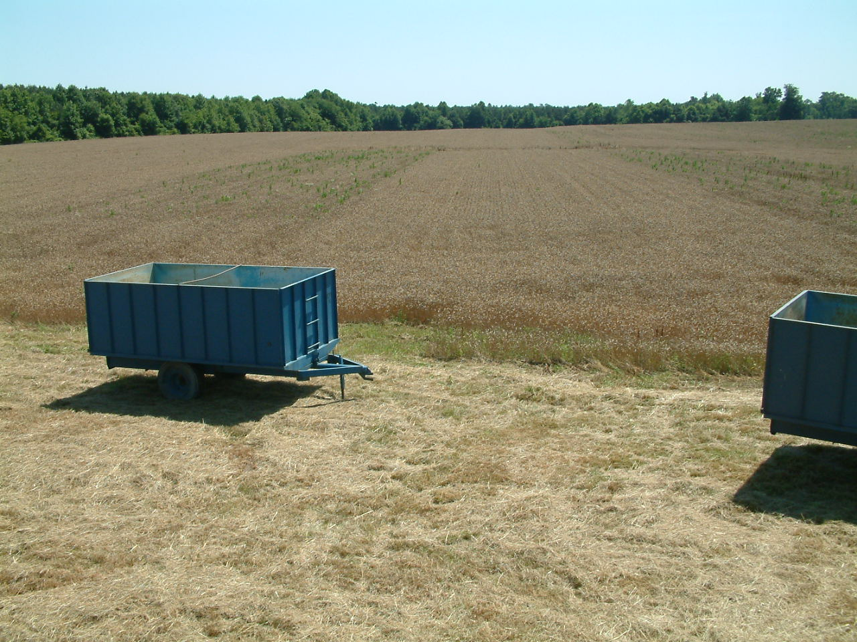
Fall Weed Control
Tillage | Weed Control | Yield (bu/ac)
NT | Gramoxone at planting Harmony Extra in spring | 95.3
NT | Harmony Extra 30-45 days after planting | 94.6
NT | Harmony Extra in spring | 92.9
NT | None | 80.4
Notes:
11 year study from UKY. Up to 40% loss in some years due to weeds. No herbicide resulted in 15-20% loss – average.

Slide 51
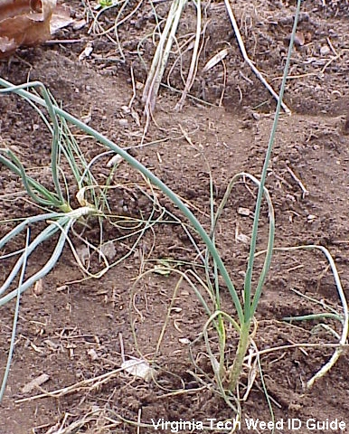
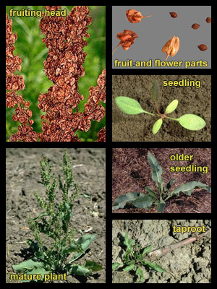
Weeds - Perennials
Wild garlic, Allium vineale
Curly Dock, Rumex crispus

Slide 52
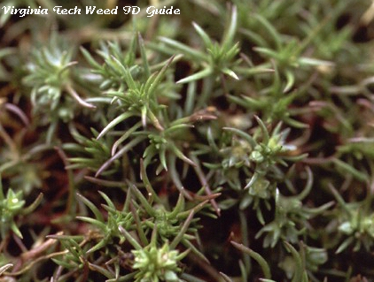
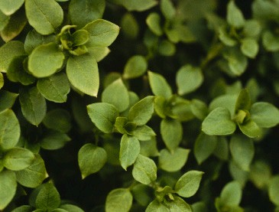
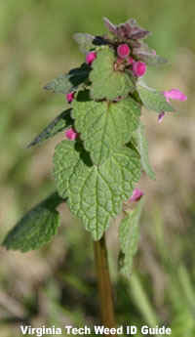
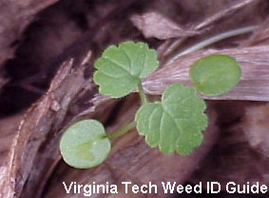
Weeds – Annual Broadleaf
Knawel, Scleranthus annuus
Chickweed, Stellaria media
Purple deadnettle, Lamium purpureum
Henbit, Lamium amplexicaule
Notes:
Henbit - Square stems with petioled lower leaves and sessile upper leaves. This weed is commonly confused with Purple or Red Deadnettle (Lamium purpureum). However, purple deadnettle has upper leaves that are triangular, occur on petioles, and are distinctly red- or purple-tinted, unlike the upper leaves of henbit.
Chickweed- The oppositely arranged small oval or elliptic leaves and stems with rows of hairs are both characteristics that help in the identification of common chickweed. Mouseear Chickweed (Cerastium vulgatum) is very similar in appearance and growth habit, however this species is densely covered with hairs unlike common chickweed.
Knawel - Identifying Characteristics: Plants with small, linear leaves that initially resemble a grass and inconspicuous green flowers. Due to the overall growth habit and leaf shape, this weed might be confused with Creeping Phlox (Phlox subulata), but the leaves and stems of German moss aren't covered in hairs like those of creeping phlox. German moss might also be confused with some of the spurries (Spergula spp.) but lacks the distinctive white or red flowers of these species.
Deadnettle - Winter annual with purple-red flowers, square stems, and petioled leaves. The petioled leaves, triangular and sometimes purplish-red upper leaves help to distinguish this weed from Henbit (Lamium amplexicaule), which has upper leaves that do not occur on petioles (sessile).

Slide 53
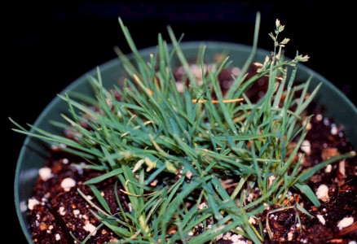
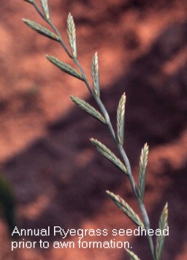
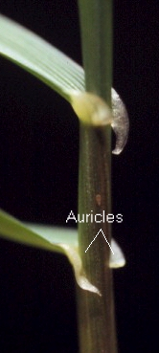
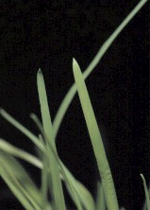
Weeds – Annual Grasses
Annual Bluegrass: Poa annua
Annual or Italian Ryegrass: Lolium multiflorum
Notes:
Ryegrass - The auricles that occur in the collar regions distinguishes this grass from other similar weeds, as relatively few grass weeds have this feature. Additionally, the red-tinged base of annual ryegrass helps to distinguish this weed from perennial ryegrass (Lolium perenne), which is very similar in growth habit and appearance.
Poa – distinct “boat-shaped” leaf tips

Slide 54
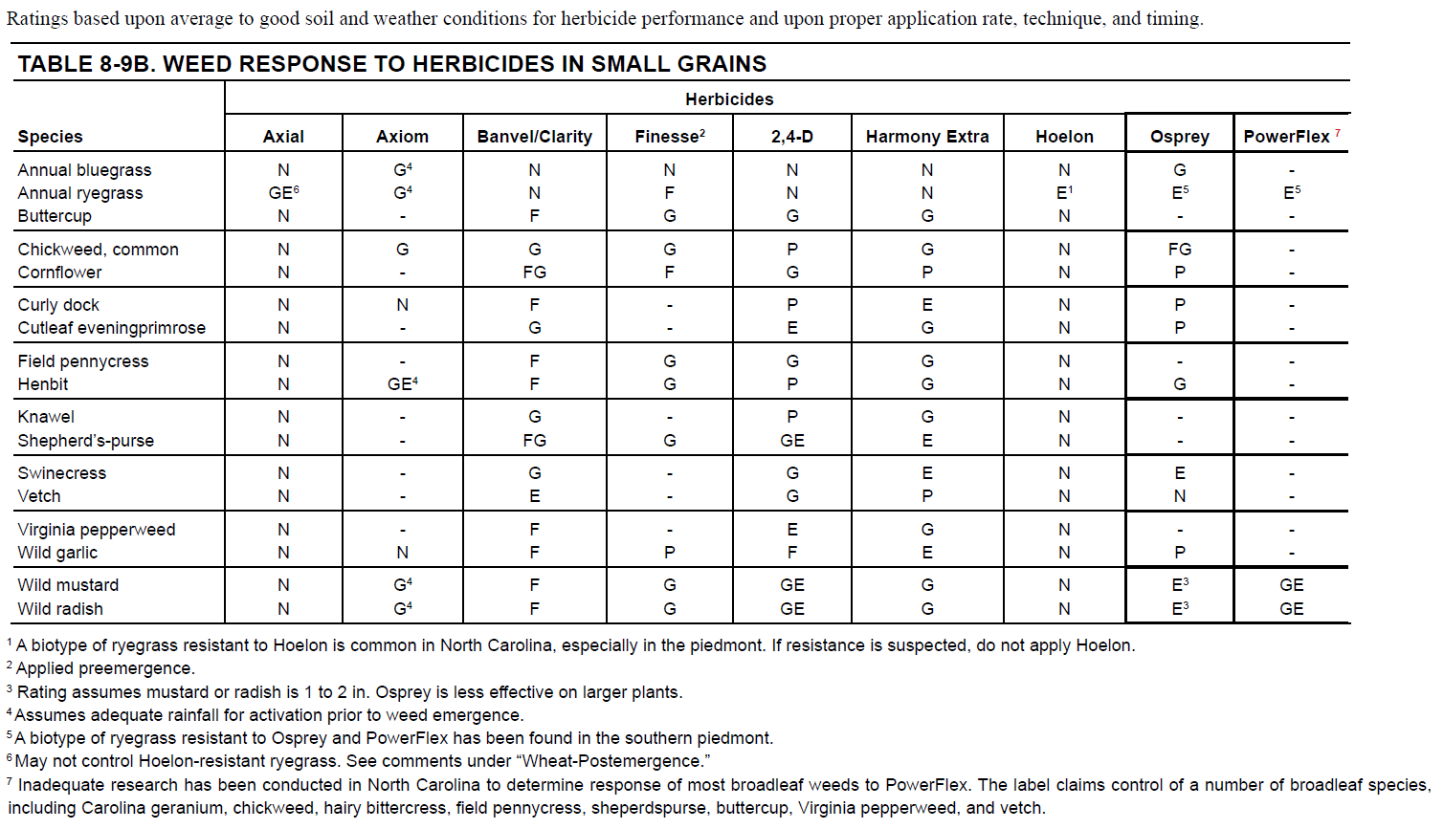
Notes:
Powerflex – RG control in wheat,

Slide 55
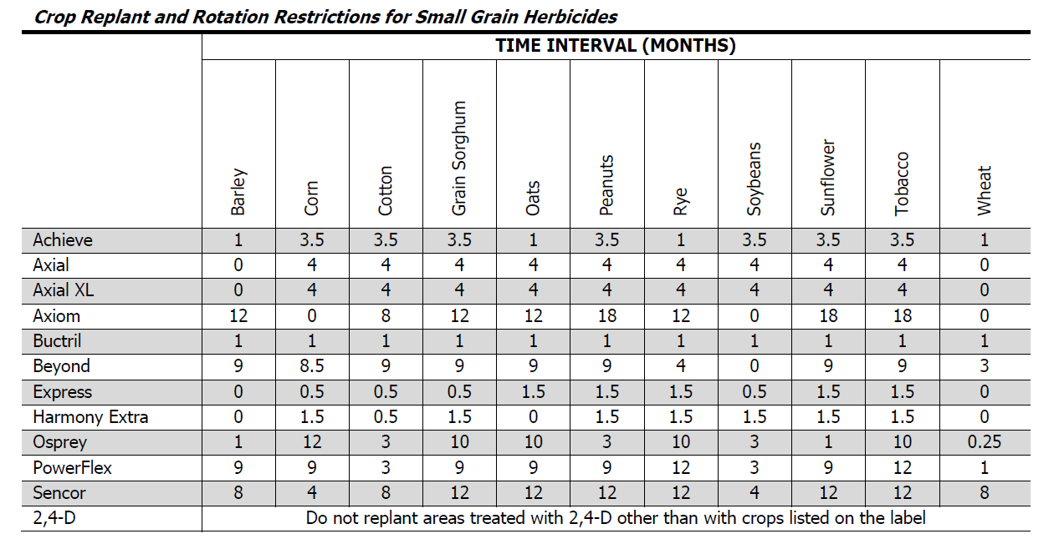

Slide 56
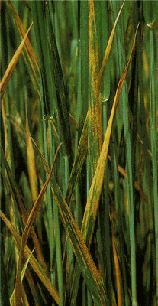

Variety Selection and Disease
Disease Susceptibility
  Varieties rated Fair or Poor demand more attention.
Notes:
Varieties differ GREATLY in their resistance to disease. The ratings we give them relate to potential disease infestation and yield loss. See the 2007 small grain variety report for this info. http://www.ext.vt.edu/pubs/grains/424-001-07/424-001-07.html

Slide 57




Insects – Hessian Fly
Mayetiola destructor
Adult - The adult Hessian fly is a small, dark, long-legged, two-winged insect which resembles a mosquito. The female fly, about 4 mm long, has a distinct reddish tinge. The brown or black male is 2.5 to 3.5 mm long and bears two pairs of abdominal claspers.
Egg - The thin, cylindrical egg is 0.4 to 0.5 mm long. Although uniformly glossy red when laid, it gradually becomes deeper red at one end and opaque white at the other.
Larva - The newly hatched maggot is red for 4 or 5 days after which it turns white. As the larva matures, a translucent green stripe appears down the middle of its back. The full grown maggot is 3.5 to 5.5 mm long and about 1 mm wide.
Pupa - The brown-headed pupa is basically white with a reddish tinge. The puparium or "flaxseed" within which the pupa is found is spindle-shaped, red to dark brown, and 2.5 to 6.2 mm in length.

Slide 58

Insects – Hessian Fly
Notes:
Hessian fly can be found in small numbers in most wheat fields at harvest (Figure 5). If the wheat stubble is destroyed after harvest, the fly dies and the life cycle is broken. If, however, the wheat stubble is left in the field, the fly can survive as “flaxseeds” in the stubble through the summer. In late August and September, adults emerge from the “flaxseed” pupal stage and lay eggs on volunteer wheat, or on early planted cover-crop wheat. A first generation can be completed on these plants, and the next generation adults emerging from cover-crop or volunteer wheat plants can lay eggs on wheat planted for grain in October and November, before the weather turns cold enough to kill the adult flies. Often Hessian flies begin depositing eggs very soon after seedling emergence.
Once established on a new wheat crop, Hessian fly eggs hatch within a few days, and the tiny maggots migrate into the whorl of small wheat plants but ultimately locate below ground at the base of the stem, where they enter the pupal stage. While feeding, the larvae damage the plants by rupturing leaf or stem cells. This can result in tiller stunting and dieback. A heavy infestation on early-stage plants may greatly reduce plant stand. A new generation of adults usually emerges in March depending on the weather, lay eggs, and produce new larvae that migrate to the stem joints where they feed and cause further damage. This spring damage may kill the wheat tiller but usually results in weakened stems, small heads, and poorly filled grain heads with low-quality kernels. Often, wheat lodges in seriously infested fields.

Slide 59
Hessian Fly Control
Rotation
Tillage
Cover crop species
Delayed planting?
Resistant varieties
Seed treatments
Insecticides
Notes:
Management
Rotation: Because the Hessian fly life cycle is largely dependent upon the presence of wheat stubble, rotations which prevent new wheat from being planted into or near a previous wheat crop’s stubble will be the most effective way to prevent infestations. Growers should avoid planting wheat into last season’s wheat stubble! Continuous no-tillage wheat-double-cropped-soybeans may result in severe problems and should be avoided in Hessian fly problem areas. Additionally, since the Hessian fly is a weak flier, putting distance between the location of new wheat plantings and the previous season’s wheat fields can be a successful method of preventing new infestations. Although Hessian fly can become serious under other situations, most serious infestations occur when wheat is early planted into wheat stubble or into fields next to wheat stubble.
Tillage: Disking wheat stubble after harvest effectively kills Hessian fly. Planting soybean no-till into wheat stubble enhances Hessian fly survival by preserving the site where puparia spend the summer. Burning wheat straw will reduce puparia but many puparia are found below the soil surface. Therefore, burning is not as effective as disking.
Choosing Cover Crops: Serious Hessian fly infestations have occurred in areas where wheat for grain was planted near early-planted wheat for cover, or early planted wheat for dove hunting purposes. In cropping systems where cover crops are used, such as in strip-till cotton or peanut production, the use of other small grains besides wheat will reduce Hessian fly populations. Oats, rye, and triticale are not favorable for Hessian fly reproduction and do not serve as a nursery making them preferable over wheat for cover cropping in areas where wheat for grain is also produced. If triticale is used for cover cropping, varieties such as “Arcia,” that are adapted to NC, should be planted.
Delayed Planting: Because Hessian fly adults are killed by freezing temperatures, a traditional method for preventing Hessian fly infestation is to delay planting until after the first freeze (often called the fly free date). This concept has not worked well in North Carolina because an early freeze is not a dependable event. Often a “killing freeze” does not occur until December in many areas of North Carolina, after most growers need to have wheat planted for agronomic purposes.
Resistant Varieties: Many wheat varieties are advertised as having Hessian fly resistance. Unfortunately, in most cases this resistance is to a “biotype” or kind of Hessian fly that we do not have in North Carolina. To be effective here, wheat varieties must be specifically resistant to “Hessian fly biotype-L”. Wheat varieties with biotype-L resistance are listed in Table 1. This list is updated every year and can be found on the the North Carolina Small Grains Production Web Site at: http://www.smallgrains.ncsu.edu/. In most cases, varieties rated as “good” in Table 1 should provide enough protection to avoid economic loses due to Hessian Fly biotype-L. However, in areas with severe Hessian fly problems, the use of resistant varieties (those shown in Table 1 as “good”) may not be sufficient to prevent infestations from occurring.
Systemic Seed Treatments: The use of systemic insecticidal seed treatments (e.g. Gaucho® {imidacloprid} or Cruiser®) can be highly effective in protecting wheat seedlings from Hessian fly. These seed treatments are, however, expensive and should be used only after careful consideration of current production economics.
Foliar Insecticides: Long residual foliar pyrethroid insecticides (specifically Warrior®) applied shortly after wheat emerges (at the two to three leaf stage) have been very effective in controlling Hessian fly. Our tests have shown that if applied timely, Warrior will kill the adult flies, may kill the eggs on treated leaves, and may also kill freshly hatched larvae before they become embedded in the stems. Pyrethroids labeled for use against Hessian fly are limited to Warrior and Mustang Max™. At least three of the following conditions should be met before using a pyrethroid for early season Hessian fly control:
1) Wheat has been planted in the same field, adjacent to, or close (within 400 yards) to the previous year’s crop. 2) A resistant wheat variety (rated as “good” in Table 1) has not been planted. 3) The seed were not treated with Gaucho or Cruiser. 4) Hessian fly has caused yield loses on this farm or nearby in previous years. 5) Hessian fly eggs are present on the wheat leaves. Fields that passed the winter with a significant Hessian fly infestation will also be attacked by the next generation of larvae recycling in the crop. Fields with low tiller counts should be examined in January or February for Hessian fly puparia. If a pyrethroid is applied as the flies emerge and lay eggs, usually in early March, a high level of control may be accomplished. The need for a pyrethroid treatment may be judged by examining the plants for puparia, to identify fields that will have high fly numbers, and later scouting heavily infested fields for eggs on the top surface of new leaves. Eggs are very small, about half the size of a period, and magnification may be needed. An experienced person with good eye sight can readily detect Hessian fly eggs, especially in direct sun-light since the eggs will shine. Egg counts of four or more per leaf may justify a pyrethroid application.

Slide 60

Insects – Aphids
Greenbug
  pale green with a darker green stripe running down the middle of the back
  Inject toxins when feeding
  Vector barley yellow dwarf virus (BYDV)
Notes:
Description
Aphids are small insects with soft, pear-shaped bodies and piercing sucking mouthparts. A pair of tubular structures,(cornicles) project like tail pipes from the end of their bodies. Adult aphids may or may not have wings. Large colonies are often seen on tender new plant foliage. Once they find a good host, nymphs and wingless adults tend to stay in one place.
Movement
Aphid movement can be categorized as flying, flitting, or walking. These are based on the method and relative distance traveled. Each type benefits the aphid in specific ways but also results in a specific type of BYDV spread.
Generally most adult aphids in a colony will be wingless. However, a small number in each generation will have wings. This allows for continual population expansion. Environmental factors such as poor weather, over- crowding and reduction in food quality cause a greater number of them to have wings so the colony can escape unfavorable local conditions.
Ways Aphids Move
Some will fly long distances. Individuals can move from one field to another field or to a weed host. Most fly in the fall. In general, they are moving from drying summer grasses to young fall grasses, including small grains. This movement brings BYDV into a wheat field.
Some will make short flights, just a few feet to to a few yards. This moves BYDV to new spots in a field.
Aphids often walk from plant to plant. This gradually expands the area of an existing population and produces circular spots of infected plants if the virus is present. The earliest infected plants are near the center and the most recently infected ones are near the edges. The spots expand in size over time.
Life Cycle
Aphid life cycles are very complicated and vary considerably between species and even between individual populations of the same species. The following is a very abbreviated description intended to help understand what is going on in Kentucky’s small grain fields.
In Kentucky wheat fields aphids reproduce asexually. That is to say all the aphids you see are female and all of their offspring are born female. Very few if any males are present and play little role in the BYD incidence. Aphids overwinter as juveniles and adults. At present we do not believe that eggs play any role as they would further north. However, temperature is very important. In general the warmer the temperature the more aphids can survive, move and reproduce. Conversely, colder temperatures result in lower survival rates, fewer offspring and less movement. As a rule of thumb it needs to be about 50o F for aphids to be active and temperatures below 30o F result in increased aphid mortality. However, even at very low temperatures some aphids will survive. A warm and dry winter will aid aphid survival and BYDV spread while a cold and wet winter will reduce aphid survival and movement.

Slide 61

Barley Yellow Dwarf Virus
Barley Yellow Dwarf Virus (BYDV)
Barley to turns a yellowish color, and infected plants become stunted and nonproductive.
Wheat and oat plants turn a reddish color and become stunted.
Patchy
Yield losses due to BYDV are more severe when young plants are infected during the fall or early winter.

Slide 62

Insects – Aphids
Bird Cherry Oat Aphid
  olive green to blueblack in color and have reddish patches at the base of the cornicles.
  Do not inject toxins while feeding
  Vector BYDV

Slide 63

Insects – Aphids
Corn Leaf Aphid
  distinctly blue to dark green in color with a darker area at the base of the cornicles.
  Do not inject toxins while feeding
  Do not vector BYDV

Slide 64

Insects – Aphids
English Grain Aphid
  grass-green in color, but can be pinkish, especially in the spring. Their cornicles and antennae are black and longer in relation to their bodies compared with other species.
  Do not inject toxins while feeding
  Vector BYDV
  Most common species in late-spring (flag leaf)

Slide 65



Aphids
Notes:
Aphids can cause major problems with wheat due to direct feeding on plants as well as spreading a virus disease named “barley yellow dwarf”. Dr. Ames Herbert, Extension Entomologist at Virginia Tech has done many years of excellent research evaluating insect pests of small grains and optimum economic control strategies. The following is based on his research and publications. Grain aphids are usually held in check by their natural enemies. However, scout grain fields at least each month of the growing season. To determine aphid activity on tillering grain, examine 20 sites throughout the field. Each site should consist of at least five linear feet of row. Look especially in the areas in the field that are showing plant stress. During the fall and winter, treatment is suggested if aphid counts exceed 15-25 per linear foot of row and a low degree of beneficial insects such as lady beetles is present. When spring growth becomes rapid the threshold increases to 100-300/row foot. At heading the threshold is 20-25 aphids/head. Warrior T, Mustang Max, and Proaxis are very effective foliar-applied chemical control methods for aphids and other insects such as cereal leaf beetle. Optimum timing for foliar application of pyrethroids to prevent barley yellow dwarf is when the wheat is in the 2-3 leaf to early tillering stages. Applying these products at planting with fertilizer or a burndown herbicide will not control aphids. Seed applied insecticides, such as Gaucho and Cruiser, are also highly effective against early season aphids and thus barley yellow dwarf. See specific chemical labels for appropriate application rates and timing.

Slide 66

Variety Selection
BYDV
  Some varieties show more symptoms than others
    Pioneer Pioneer 26R15 vs. 26R22
    SS 8404 vs. SS 8302
Notes:
26R15 is has low BYDV scores so is showing less symptoms than R22
Same goes for SS 8404. Has low BYDV score.
These (low BYDV symptoms) may need less protection than those that show a lot.
For eg. If a farmer has a variety that shows a lot of BYDV (ranked that way by us) then

Slide 67
BYDV hits—Easley Farm, 2005
(10’ x 140’ plots)
Total hits per plot
Herbert, 2005 BYDV2
Notes:
These are old but illustrate the point. You might want to contact Ames for current data.

Slide 68
Yield—Easley Farm, 2005
(small plots)
a
a
a
ab
cd
Yield (Bu/A)
cd
Raxil + Warrior 2.56 oz
e
Herbert, 2005 BYDV1

Slide 69
BYDV hits—Davis Farm, 2005
(20’ x 45’ plots)
+ Warrior T
No Warrior T
Total hits per plot
a
ab
b
b
b
c
c
cd
cd
cd
d
d
Herbert, 2005 BYDV3

Slide 70
Aphid Counts—Salmons Farm, 2005
(treatments applied Mar. 30)
Apr. 1
Apr. 4
a
a
Mean no. aphids/row ft
b
bc
bc
c
c
c
b
b
b
b
b
b
Herbert, 2005 APH1

Slide 71

Cereal Leaf Beetle
Cereal leaf beetle adults move into small grain in late February and early March and deposit eggs which hatch into larvae.
Larvae feed on grain, stripping leaves of valuable photosynthetic tissue.
Once wheat reaches the hard dough stage, beetle damage has little effect on yield and controls are not needed.
Notes:
Adults:
Adults overwinter in fallen leaves, ground litter, or other debris, within wooded areas, or other protected sites in the vicinity of last seasonºs grain fields.
In the spring, they lay eggs in small grain fields.
Eggs:
Egg laying occurs during late-March through mid-April with adults preferring late-planted and thinly sown fields.
Eggs hatch in about five days.
Larvae:
Larvae develop in 10 -12 days.
Peak larval populations occur in mid-April to early-May.
Small larvae eat a very small amount, but when full grown have a voracious appetite.
Upon reaching full size, they dig into the ground and pupate.
New Adults in Corn:
After a short period in the soil, a new summer generation of adult beetles emerges in late-May and June.
New beetles move from small grain fields and feed on grass plants, including corn in fields adjacent to the small grain fields.
Adult feeding on corn appears like many line-etchings on the leaf blades. Damage is cosmetic rather than yield reducing.
Adults do not lay eggs in corn.
They remain inactive through most of the summer.
In the fall, beetles move to overwintering sites.
There is only one generation per year.
Cereal leaf beetle adults move into small grain in late February and early March and deposit eggs which hatch into larvae. Larvae feed on grain, stripping leaves of valuable photosynthetic tissue. Larvae feeding on leaves reduce yield as well as test weight. Treatment should be considered if 25 total eggs or small larvae are found on 100 stems. Of that 25, at least half should be larvae. Once wheat reaches the hard dough stage, beetle damage has little effect on yield and controls are not needed. Warrior T is the most extensively used insecticide for cereal leaf beetle control in Virginia because it is effective when applied in the late egg and early larvae stages.

Slide 72

Cereal leaf beetle damage to wheat

Slide 73

Cereal leaf beetle threshold
25 eggs/small larvae per 100 stems

Slide 74


Slide 75

Treatment | Chemical | Rate | Application Date | Yield bu/A
Untreated | Untreated | --- | --- | 75.4 a
Automatic | Warrior II | 1.92 oz/A | 3/16/2010 | 77.8 a
IPM | Warrior II | 1.92 oz/A | 4/16/2010 | 83.4 b

Slide 76
Calendar-based vs. IPM wheat trials, 2009-2010
Location | Treatment* | CLB larvae/row ft | Yield (bu/A)
Augusta Co. | Treated (Apr 6) | 0.0 – 0.5 | 67
 | Untreated | 0.0 – 0.3 | 66
Blacksburg | Treated (Apr 5) | 0.0 | 111
 | Untreated | 0.0 | 109
Suffolk | Treated (Apr 1) | 0.0 – 0.5 | 62
 | Untreated | 0.0 – 0.4 | 61
Painter | Treated (Apr 2) | 0.0 | 79 a
 | Untreated | 0.3 – 2.5 | 67 b
Warsaw | Treated (Apr 1) | 0.0 | 75
 | Untreated | 0.0 | 74
Blackstone | Treated (Mar 31) | 0.0 – 0.9 | 37
 | Untreated | 0.0 – 2.5 | 29
Orange Co. | Treated (Apr 1) | 0.0 | 62
 | Untreated | 0.0 – 0.1 | 62
*Warrior II @ 1.28 oz/A

