Slide 1
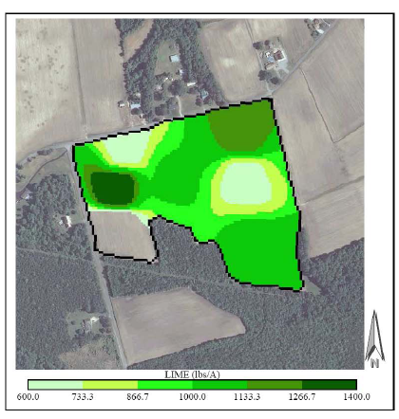
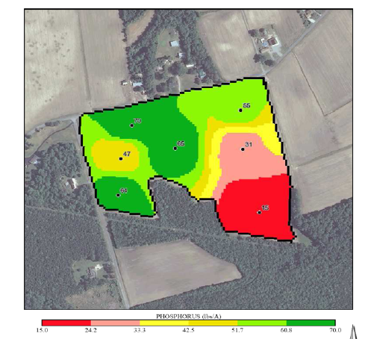
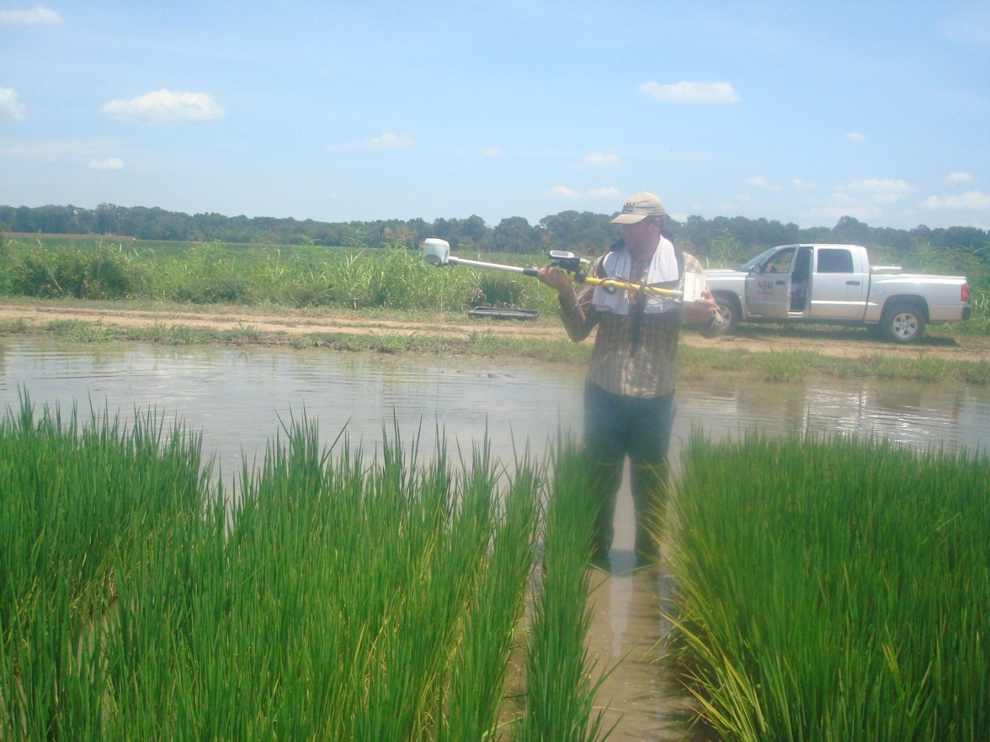
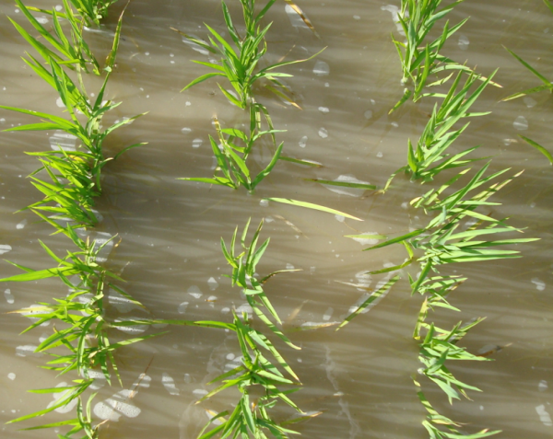
Precision Ag in the Southeast USA
Wade Thomason
Virginia Tech
Grain Crops Specialist

Slide 2
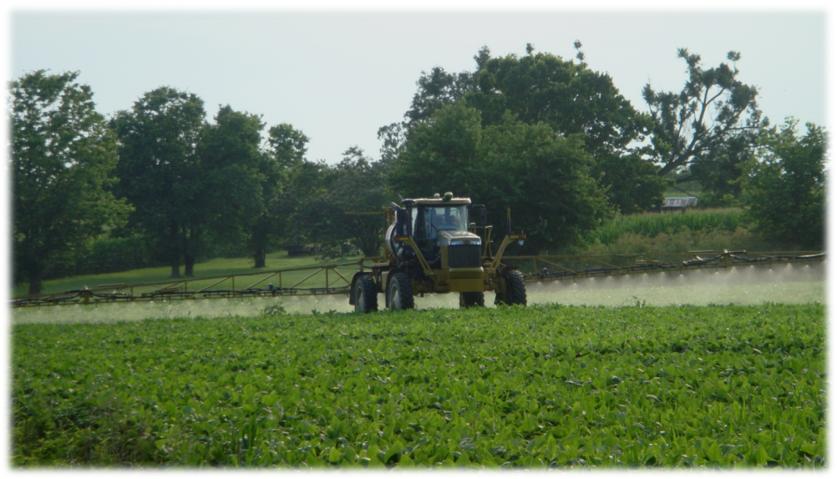





Precision Ag in the Southeast USA
Thanks to the contributors:
  Carl Crozier, NCSU
  John Fulton, Auburn
  Terry Griffin, U of Arkansas
  Will Henderson and Ahmad Khalilian, Clemson
  Brenda Tubana, LSU

Slide 3
Precision Ag in the Southeast USA
Current state of adoption and promising applications
Precision land leveling and drainage for water management
Map- and Sensor-based variable rate nutrient application
On-farm research support
Precision irrigation
Precision/VR seeding

Slide 4
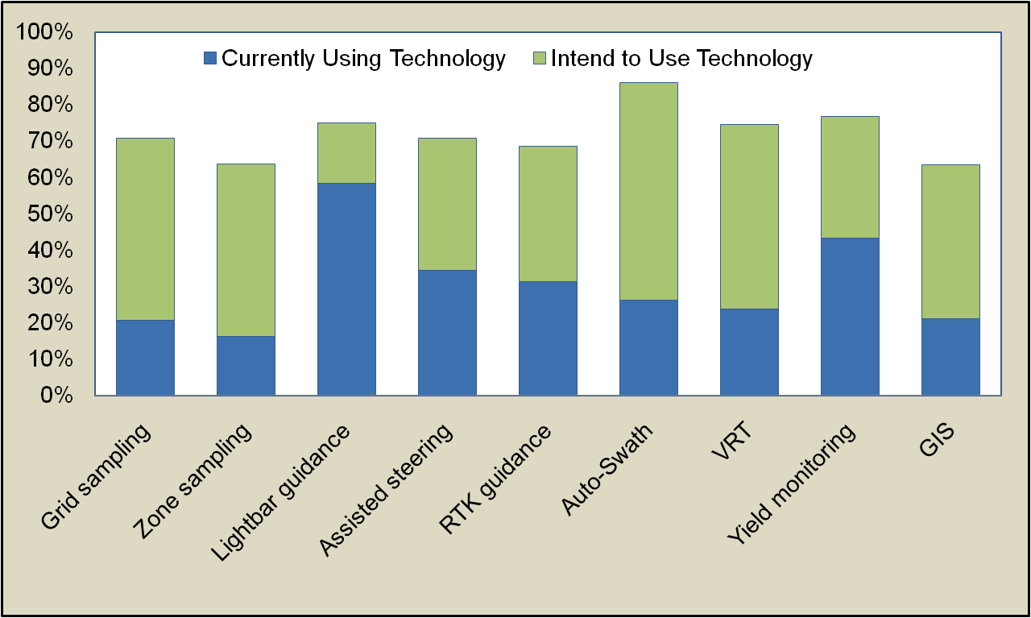
Precision Ag Adoption in Alabama
Farmer responses at the Alabama Cooperative Extension System (ACES) 2009 Precision Agriculture and Field Crops Conference

Slide 5

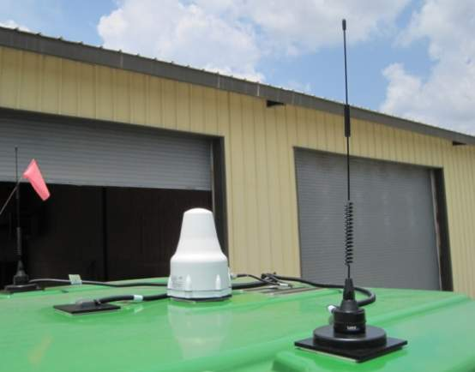
GPS-enabled Navigation Technologies Adoption
Service Providers
Notes:
Add W&A market area with GPS NT
Add roundup ready adoption curve

Slide 6
SPATIAL VARIABILITY
Bojac 1A
60 acre field in Caroline County, VA
Wheat yields: 44 to 80 bu/acre
Corn yields: 85 to 178 bu/acre
Wickham 4A
Wickham 3A
Bojac 2A
Opportunity for VR Fertilization, Liming, and Seeding Rate??

Slide 7
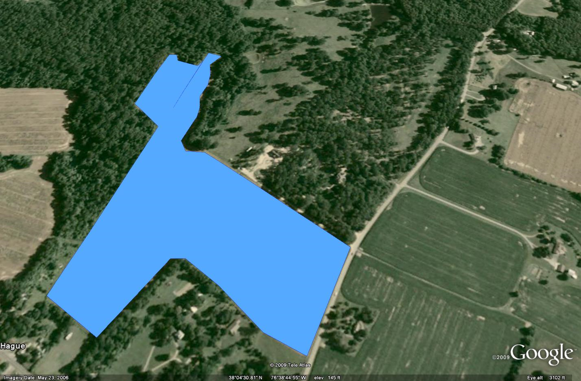
Irregular Fields
2 passes w/ 12 row planter = 10.6 ac (~30%)
Total area covered by planter = 46.2 ac
Total area double planted = 2.99 ac
34.7 ac

Slide 8
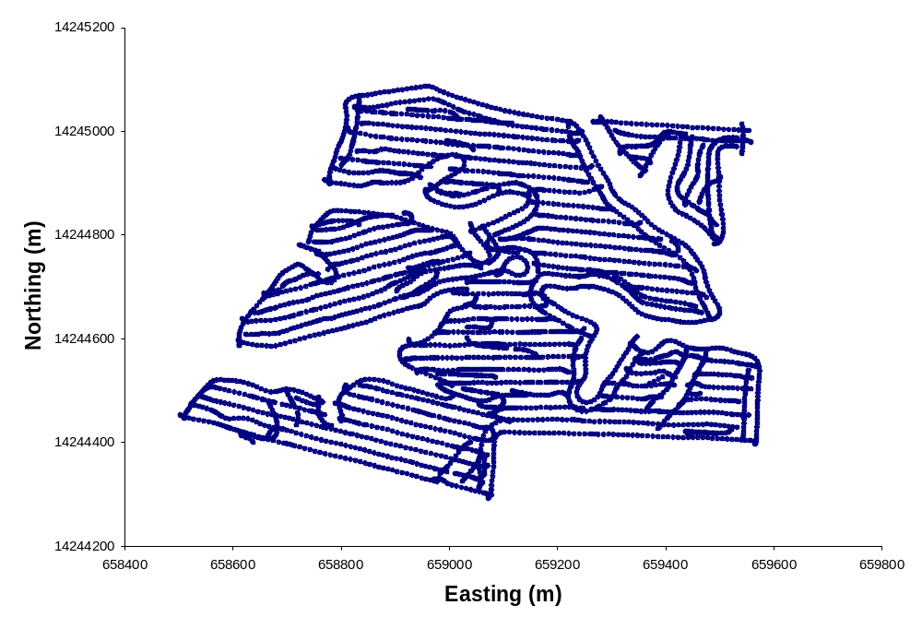
Waterways and Tree Rows

Slide 9
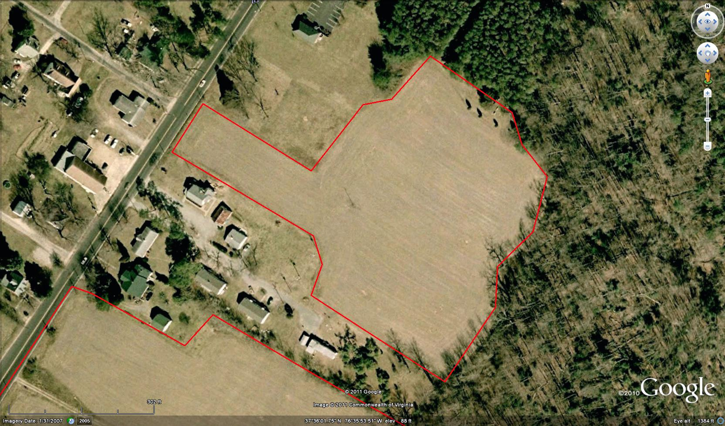
Small Fields
5.4 Ac

Slide 10
Precision Ag: The Tale of Two Technologies
Information-intensive & Embodied-knowledge
Information-intensive
Field level data to make decisions
Requires additional data and skill
IPM
Embodied-knowledge
Information purchased in the form of an input
Requires minimal additional data/skill
Round-up Ready or Bt
Yield monitors
Traditional variable rate applications
*Data
Automated guidance
On-the-go sensors applying variable rates
*Automated

Slide 11
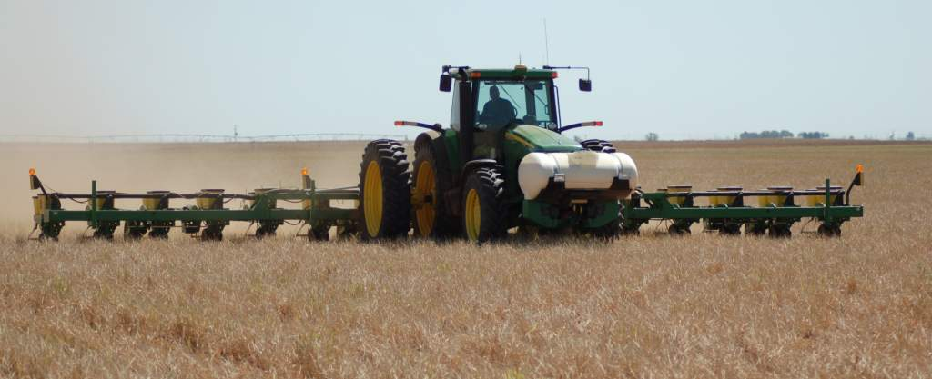
Variable-rate Seeding of Cotton and Corn

Slide 12
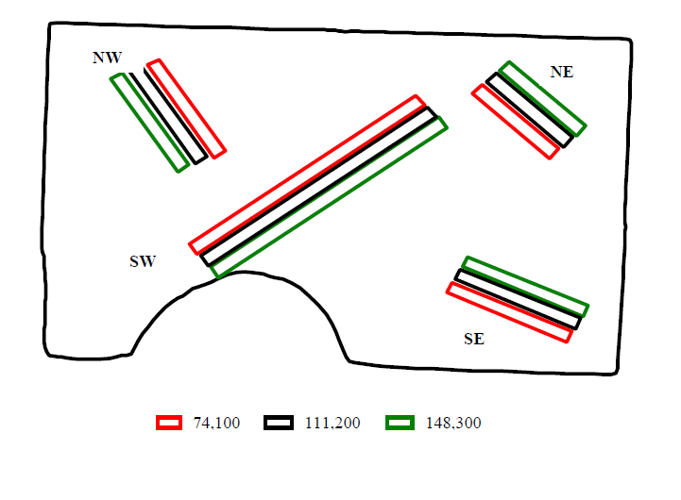
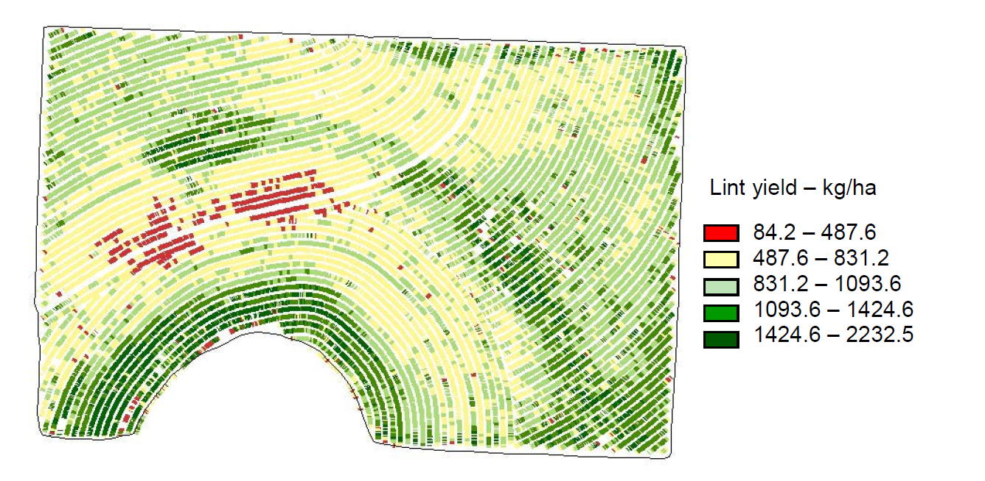
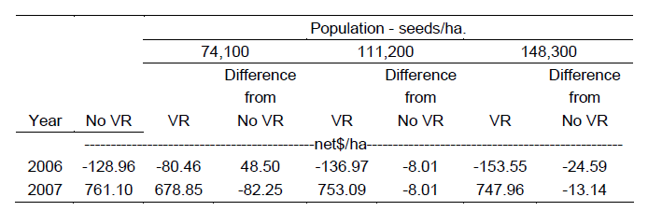
Cotton – Brosch, 2008

Slide 13
Corn VR Seeding
Bojac 1A
Wickham 4A
Wickham 3A
Bojac 2A

Slide 14
Seed Savings
As opposed to planting whole field at 26K
Seed Corn Prices | VR Seeding Savings, w/ 50% low YP soils
$/bag | ---------$/ac---------
100 | 6.65
120 | 7.75
140 | 8.85
160 | 9.95
180 | 11.05
200 | 12.15
220 | 13.25
% of land with low yield potential | VR Seeding Savings
 | ---------$/ac---------
5% | 0.13
10% | 0.30
25% | 4.73
50% | 12.15
75% | 19.45

Slide 15
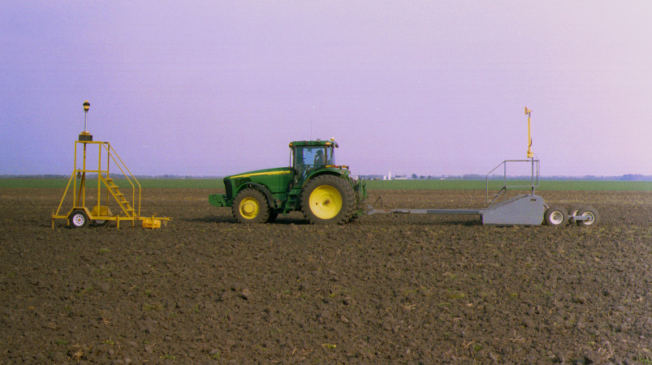
Levelling / Reshaping / Land Smoothing
Laser source at fixed point
  Projects light beam of desired slope
  2-D capability (slope along length and width)
Receiver on land level blade
  Lowers(cuts) / Raises (dumps) blade as needed to achieve desired elevation

Slide 16
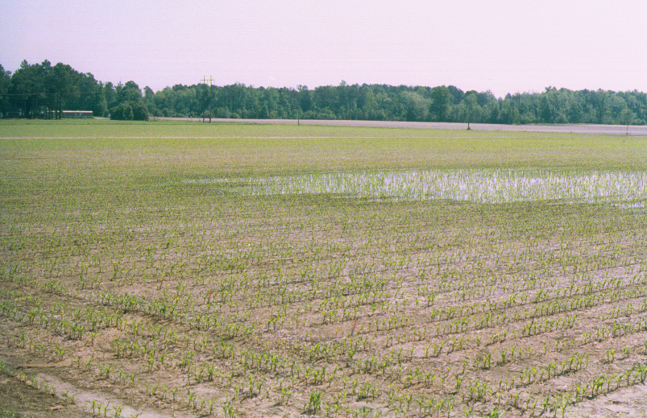
Typical NC Coastal Plain: subtle topographic/texture changes, substantial variation in crop environment

Slide 17
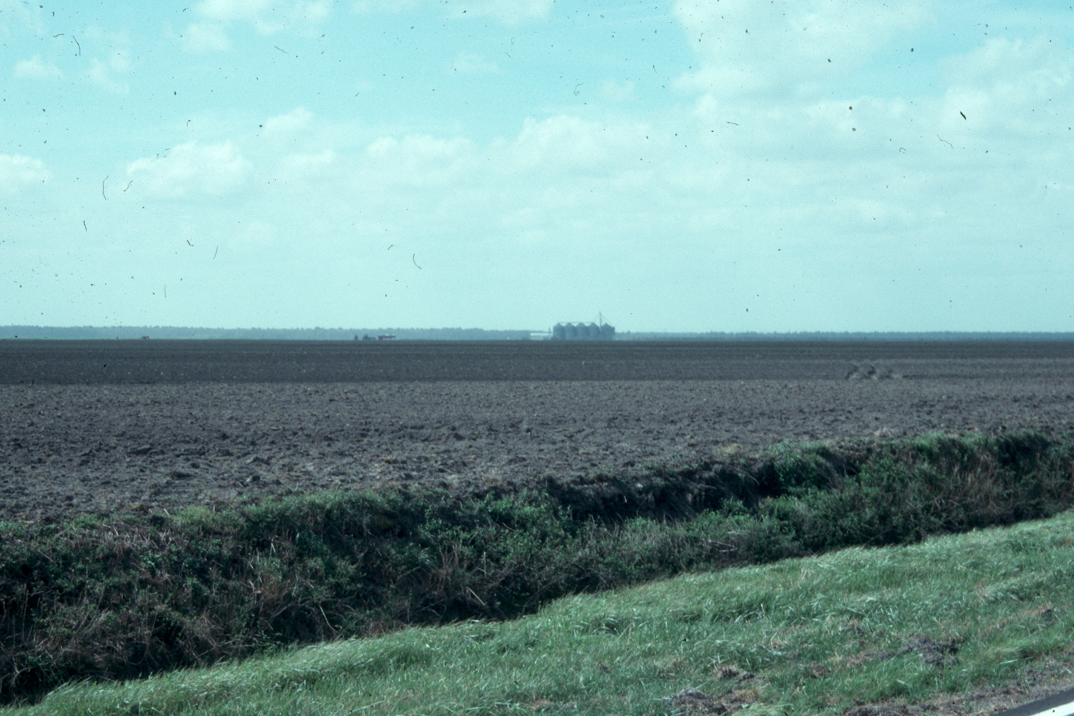
Tidewater region, Tyrrell County
Average Slope 0.5 ft per mile

Slide 18
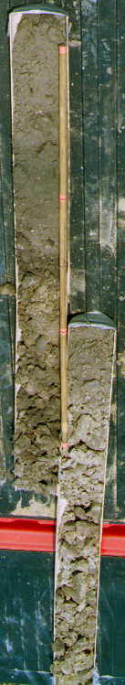
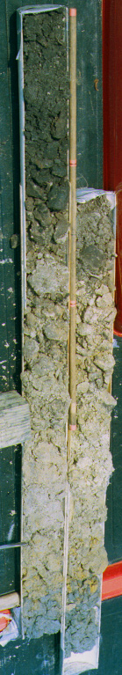
Field crowns & topsoil thickness
“non-precision” levelled
24” topsoil thickness difference
15” topsoil thickness difference
Portsmouth soil
(crown & ditchbank)
Roanoke soil
(crown & ditchbank)
Consequences of cut/fill operations
soil following land preparation can be variable even if the surface is uniform.

Slide 19
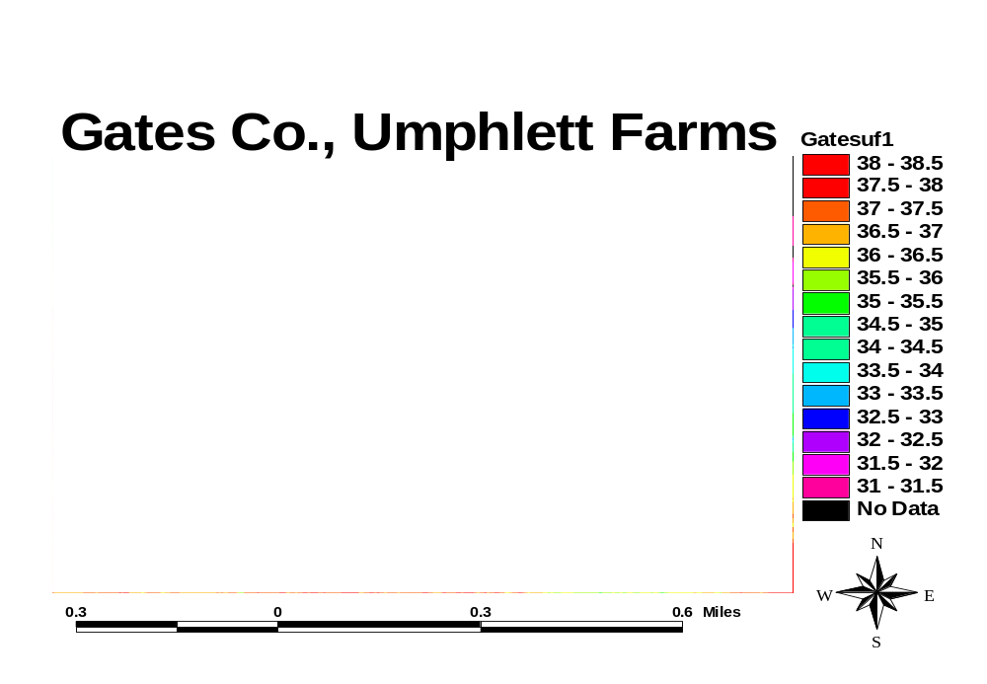
Pantego fine sandy loam, 0-2% slopes
Elevation (ft) from ncfloodmaps

Slide 20
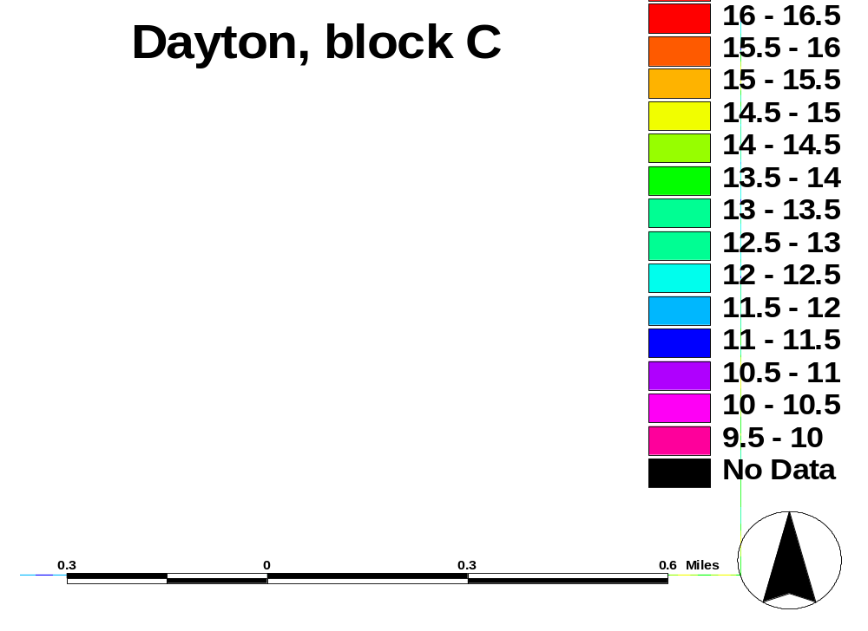
Beaufort Co Site (data from ncfloodmaps)
Broad, flat areas
8
7
Depression
6
5
4
3
2
1
Elev (ft)
Distinct crowns/ditches (ht. varies)

Slide 21
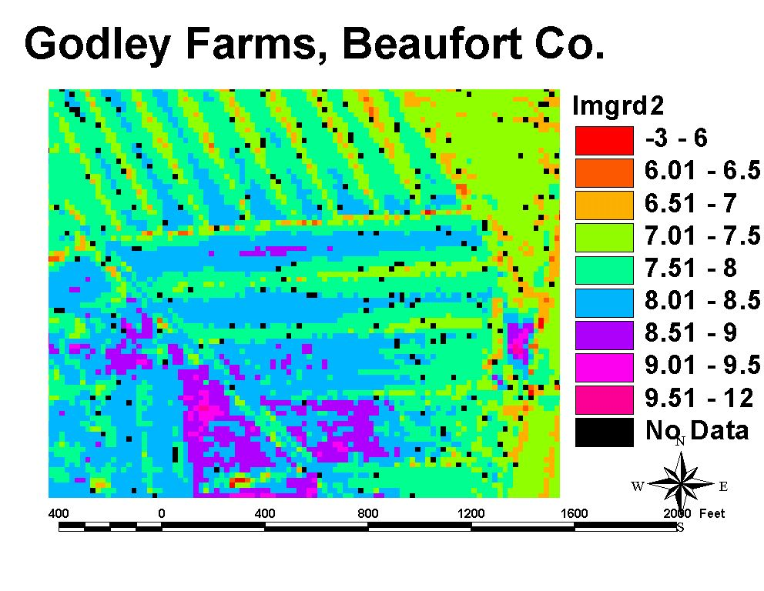
In Tidewater fields: visualize ditch & crown relief
Beaufort Co Site (data from ncfloodmaps)
Elev. (ft)

Slide 22
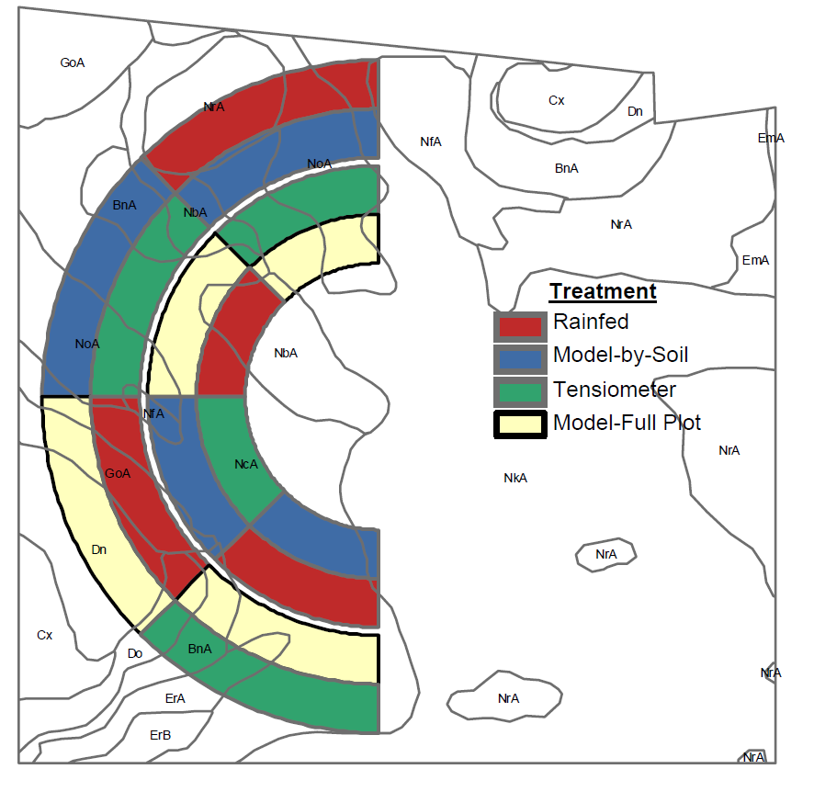
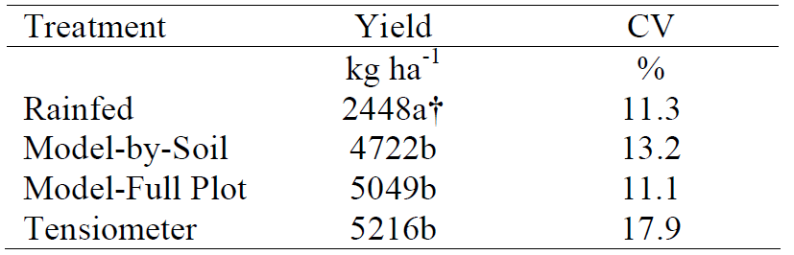
Site-specific irrigation
Evaluation of Irrigator Pro model for Peanuts
Coastal Plains Soil, Water, and Plant Research Center
Florence, SC
Bauer et al., 2008
Notes:
SITE-SPECIFIC IRRIGATION OF PEANUTS ON A COASTAL PLAIN
FIELD
Philip J. Bauer, Kenneth C. Stone, Warren J. Busscher, Joseph A. Millen,
Dean E. Evans, and Ernest E. Strickland
USDA-ARS, Coastal Plains Soil, Water, and Plant Research Center
Florence, SC

Slide 23
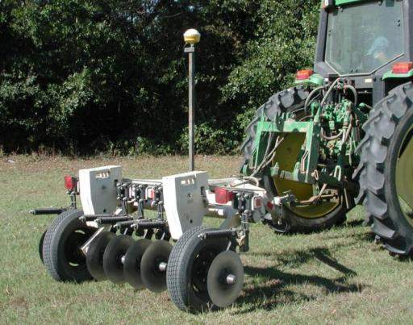
Primary Component of SNP
Generating management zones based on inexpensive geo-referenced field soil EC maps or yield maps (multi-year).
Notes:
A primary component of SNP is the generation of accurate, inexpensive geo-referenced, soil EC maps for each field to allow visualization of textural differences referred to as “management zones”. Once a map of management zones has been constructed for each field, the zones become the units for targeting nematode sampling.

Slide 24
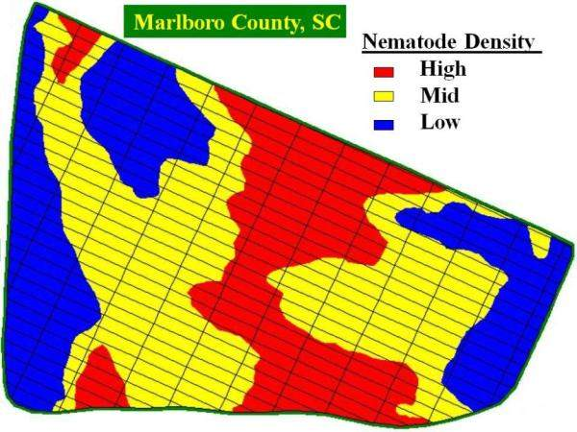
Primary Component of SNP
The management zones become the units for targeting nematode sampling.
Notes:
The soil EC zones are then used to develop a nematode management map for each field based on targeted sampling for assay and quantification of nematode population densities;

Slide 25
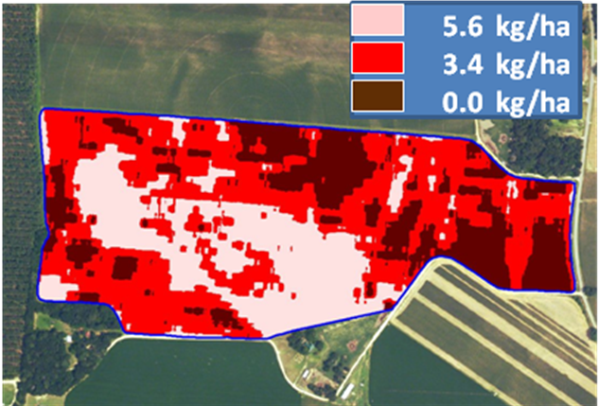
Primary Component of SNP
3. Geo-referenced nematicide application prescription maps are generated (rates are for Temik 15G).
5 lbs/ac
3 lbs/ac
0 lbs/ac
Notes:
The soil EC zones are then used to develop a nematode management map for each field based on targeted sampling for assay and quantification of nematode population densities;

Slide 26
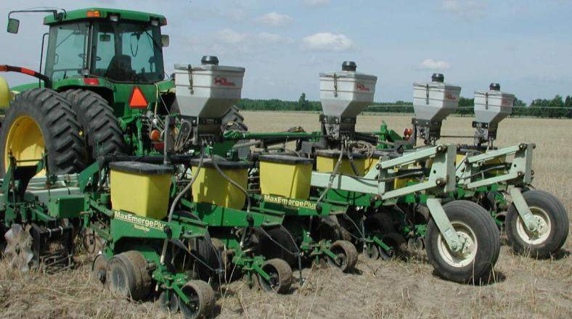
Primary Component of SNP
Nematicides are applied site-specifically using GPS-guided, variable-rate application equipment.
Notes:
The soil EC zones are then used to develop a nematode management map for each field based on targeted sampling for assay and quantification of nematode population densities;

Slide 27
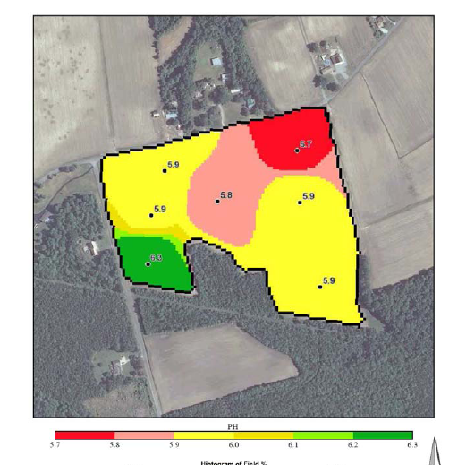
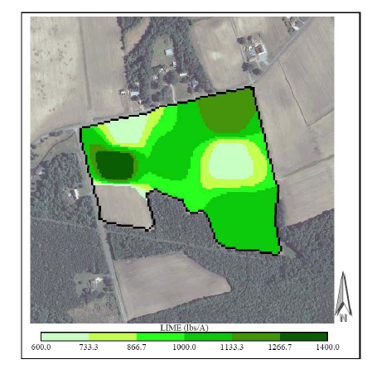
Map-Based VR Nutrient and/or Lime Application
Return of grid or zone-based soil maps?
Notes:
33 acres in SE Virginia on loamy sand

Slide 28
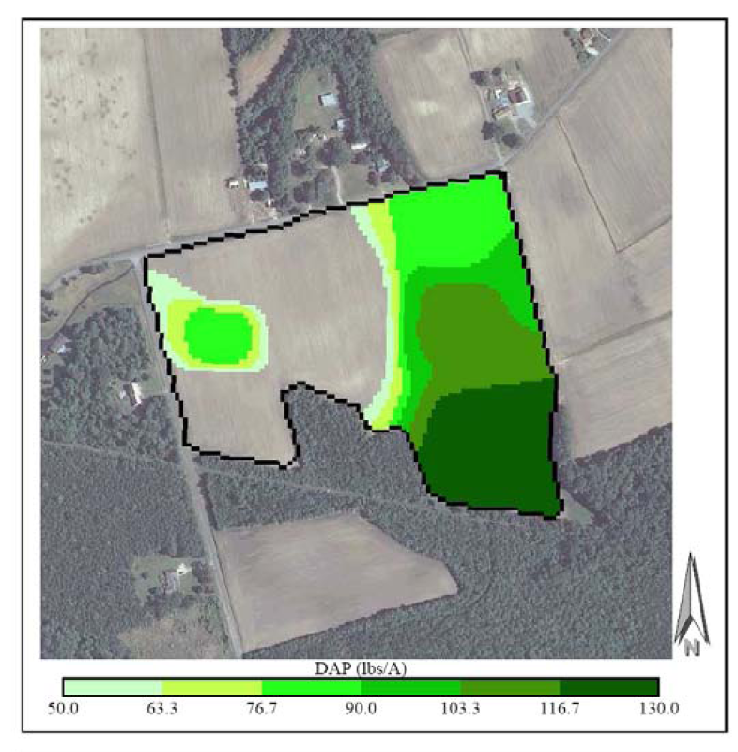
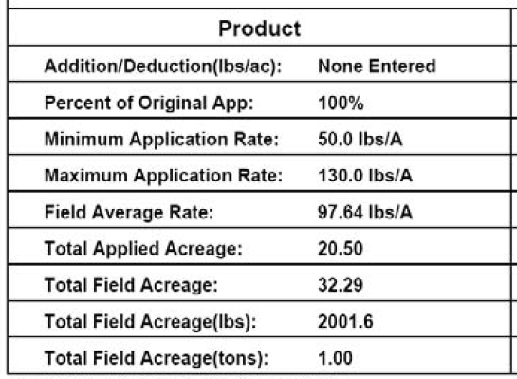
VR Phosporus Map

Slide 29
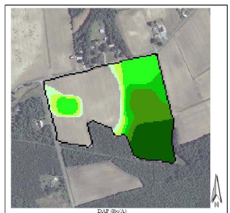
Questions remain?
 |  | Rec Rate
STP, ppm | Rating | lb/ac P2O5
15 | M | 60
31 | H | 30
47 | H+ | 20
55 | H+ | 20
64 | VH | 0
65 | VH | 0
70 | VH | 0
Notes:
20 lb P205 = 43 lb DAP. Can we reliably spread that?
60 lb/ac 130 lb DAP/ac.

Slide 30
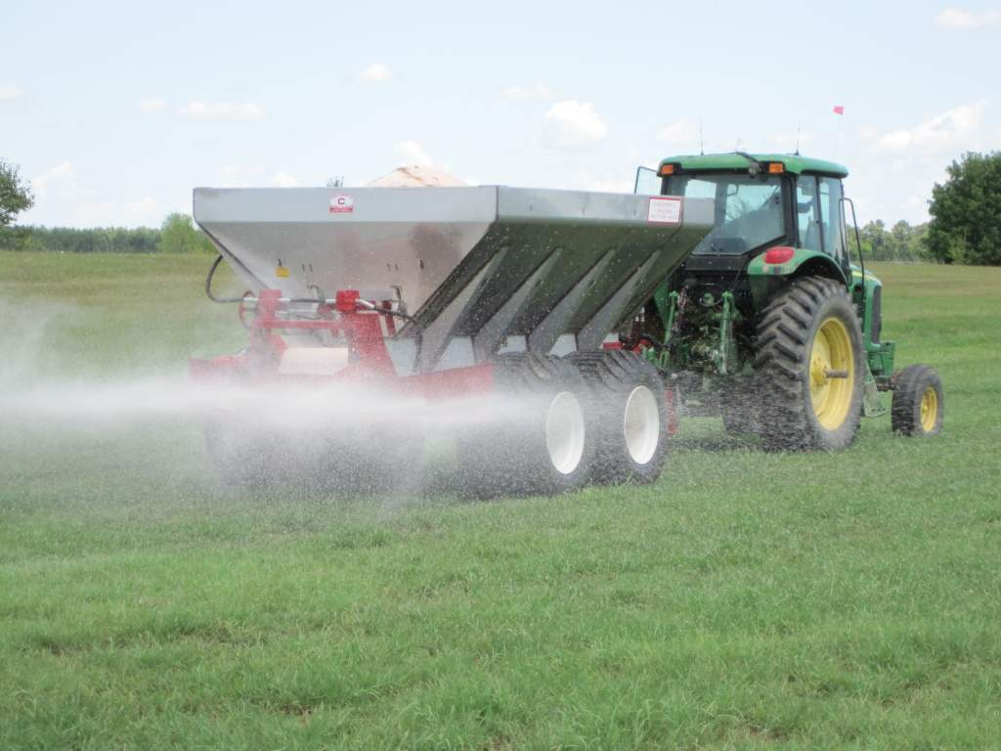

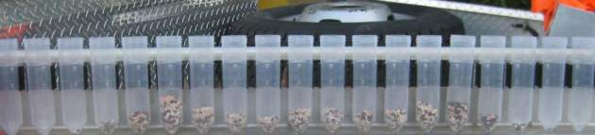
Dry Fertilizer Application
Calibration and management
Segregation of blends
Variable-rate application

Slide 31
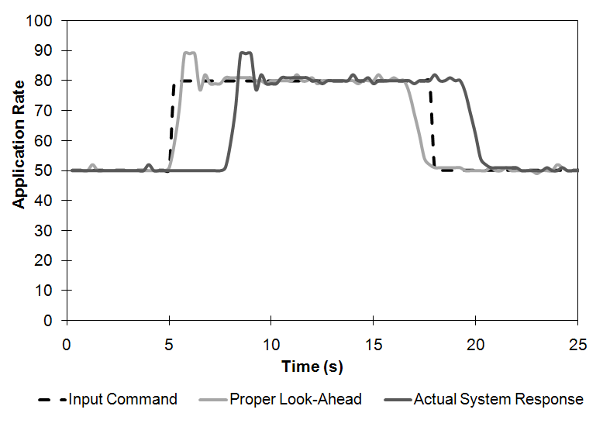
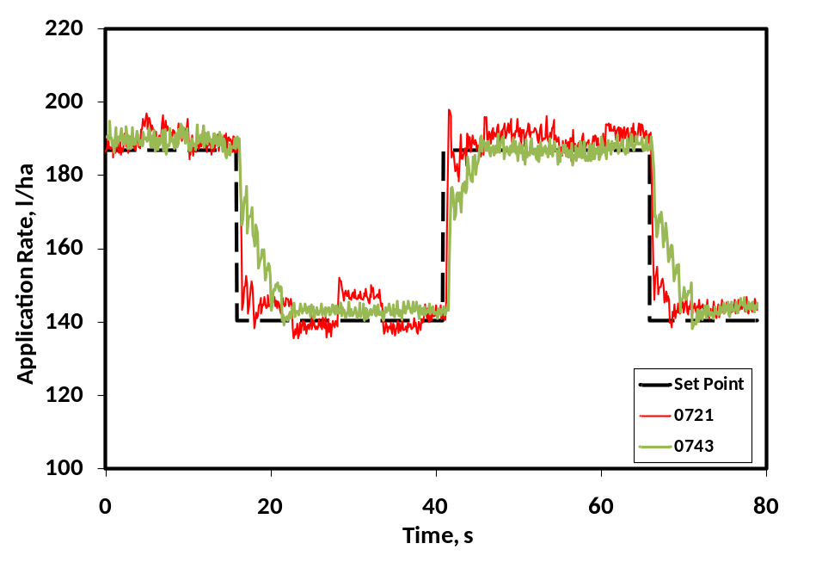
Variable-rate Controller Response
Look-ahead feature
Controller Setup
(valve control number)
Time require to make rate change
Setup impacts performance

Slide 32
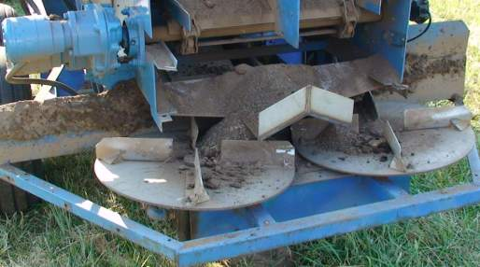
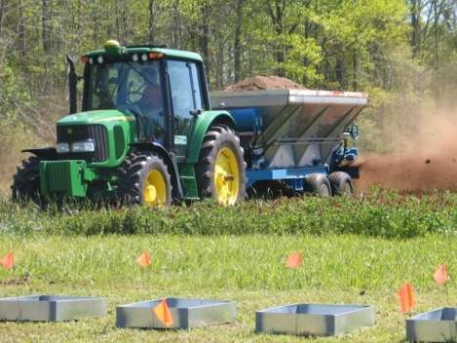
Spinner Speed Control for Litter Spreaders
Maintain set spreader width
Improves uniformity by 16% if changing rates
  Variable-rate application (VRA)
  Changing rates between fields

Slide 33
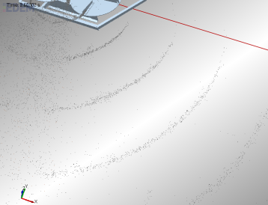
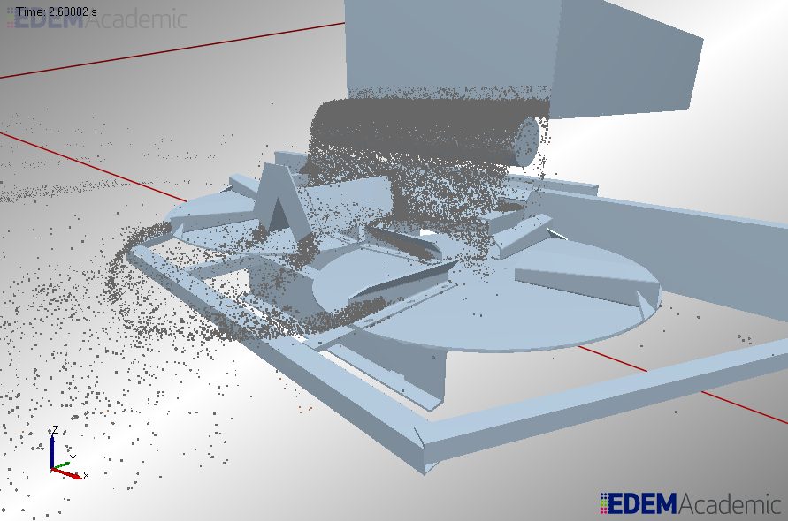
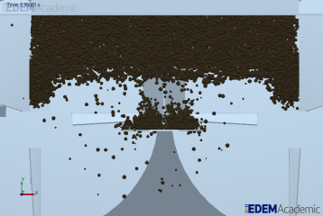
Spreader Modeling
Improve design and user management

Slide 34
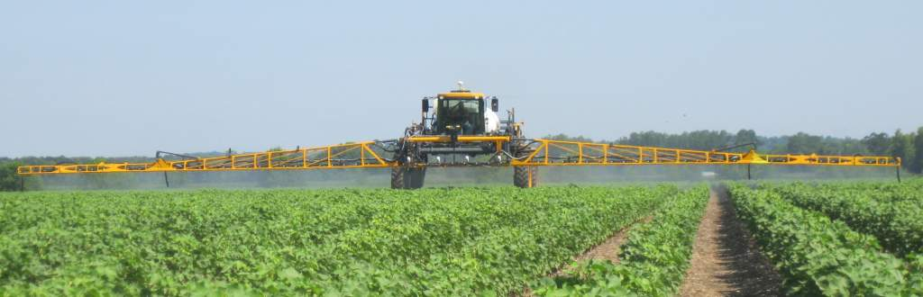
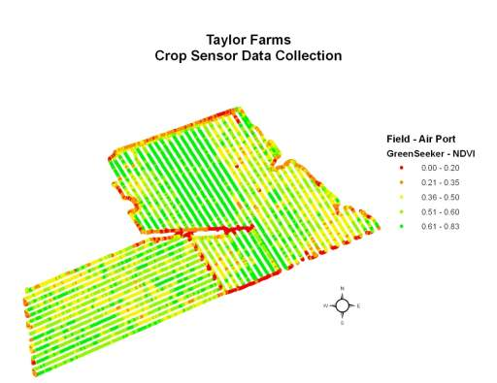
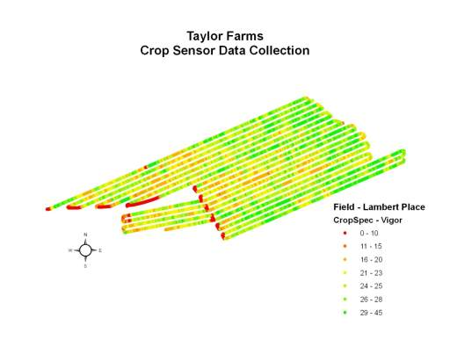
On-the-Go Crop Sensors

Slide 35

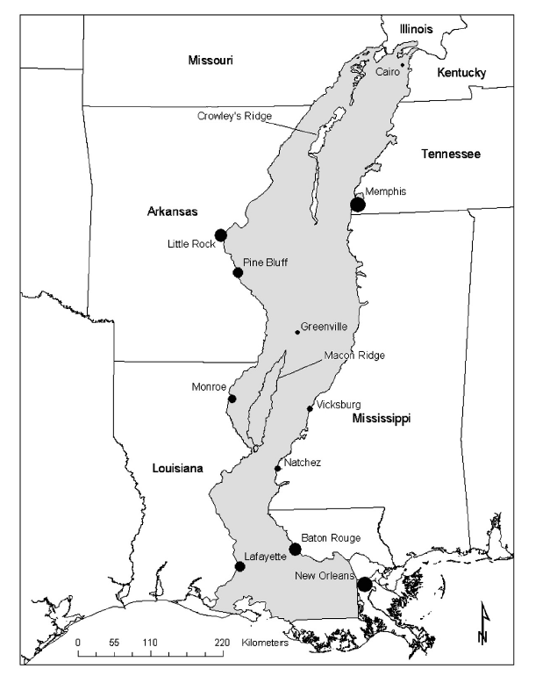
Remote Sensor Research in Rice
(Mid-South)
Sites
  Louisiana: Crowley, Lake Arthur, Rayville
  Mississippi: Stoneville, Leland, Boyle
Boyle
Stoneville
Leland
Rayville
Crowley
Lake Arthur

Slide 36
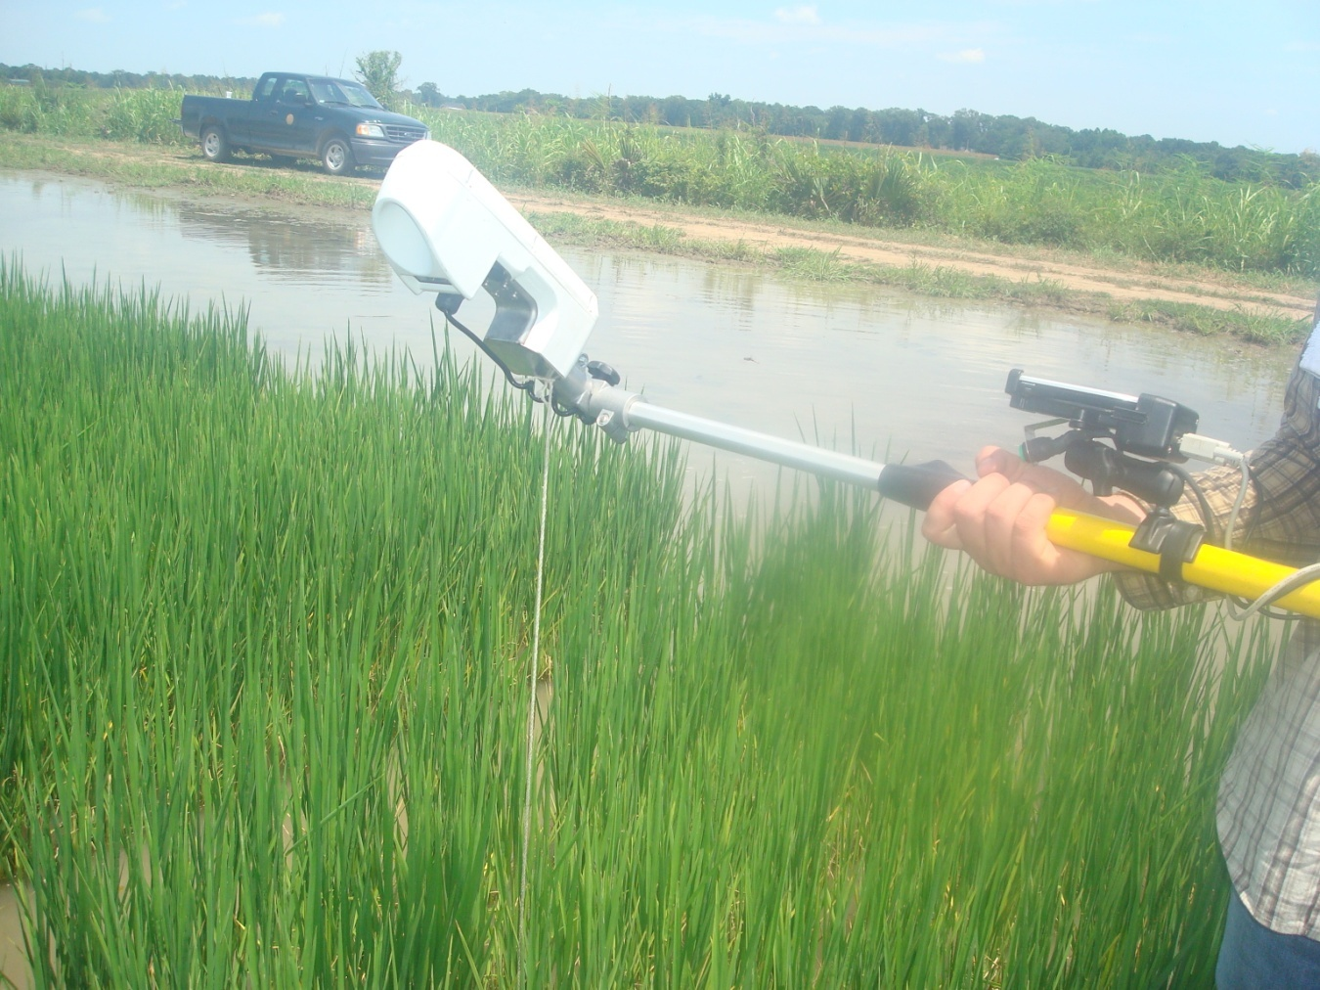
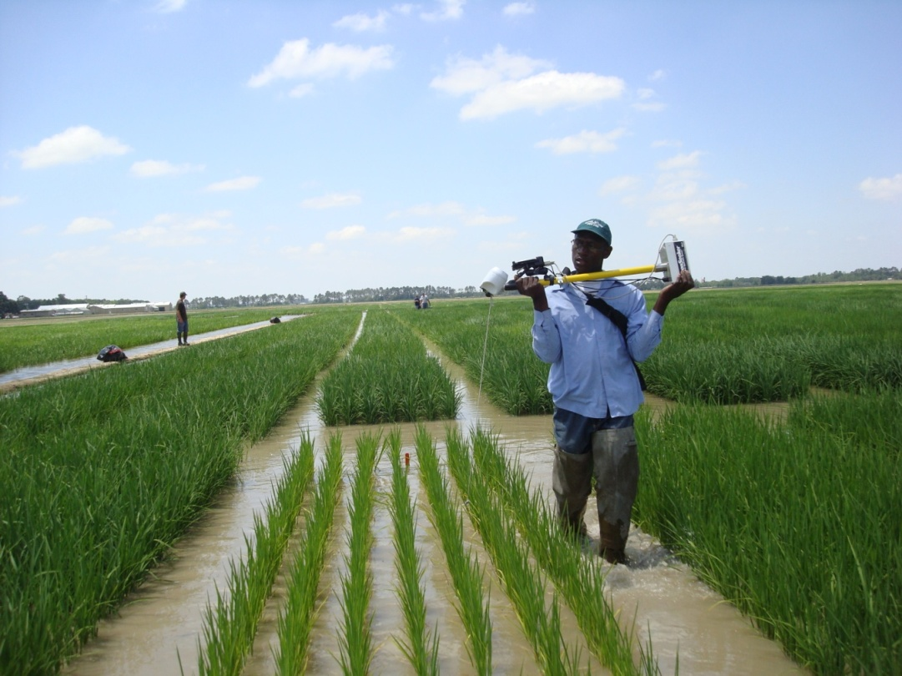
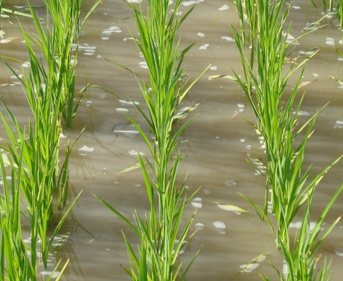
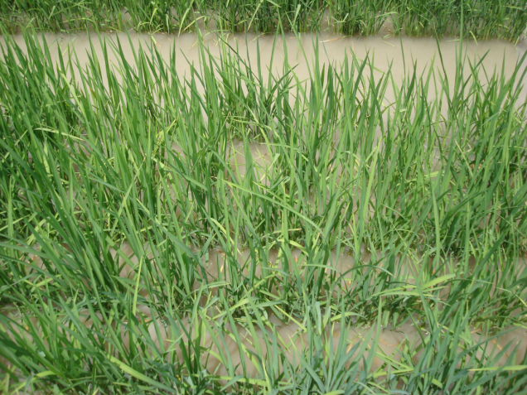
Specific Objectives
Evaluate the effect of water reflectance on sensor readings.
Identify sensing scheme to minimize water reflectance interference on sensor readings.

Slide 37
Coefficients of Determination (r²) in Exponential Regression
Between Biomass and Indices at Different Growth Stages
NDVI
SR
 | Nadir | Tilted | Twisted
Panicle Differentiation | 0.66 | 0.68 | 0.75
50 % Heading | 0.69 | 0.61 | 0.62
 | Nadir | Tilted | Twisted
Panicle Differentiation | 0.6 | 0.6 | 0.63
50 % Heading | 0.64 | 0.6 | 0.64
 |  |  | Nadir | Tilted | Twisted
2009 | Panicle Differentiation | Site 1 | 0.45 | 0.47 | 0.78
 |  | Site 2 | 0.5 | 0.51 | -
 |  | Site 3 | 0.82 | 0.76 | 0.82
 | 50 % Heading | Site 1 | 0.64 | 0.6 | 0.62
 |  | Site 2 | 0.48 | 0.21 | 0.33
 |  | Site 3 | - | - | -
2010 | Panicle Differentiation | Site 1 | 0.68 | 0.58 | 0.71
 |  | Site 2 | 0.78 | 0.8 | 0.82
 |  | Site 3 | 0.78 | 0.82 | 0.79
 |  | Site4 | 0.61 | 0.43 | 0.58
 | 50 % Heading | Site 1 | 0.55 | 0.5 | 0.49
 |  | Site 2 | 0.85 | 0.78 | 0.82
 |  | Site 3 | 0.83 | 0.81 | 0.77
 |  | Site 4 | 0.8 | 0.77 | 0.7
 |  |  | Nadir | Tilted | Twisted
2009 | Panicle Differentiation | Site 1 | - | 0.46 | 0.64
 |  | Site 2 | 0.37 | 0.47 | 0.41
 |  | Site 3 | 0.81 | 0.8 | 0.81
 | 50 % Heading | Site 1 | 0.51 | - | 0.52
 |  | Site 2 | 0.36 | 0.18 | 0.29
 |  | Site 3 | 0.71 | 0.67 | 0.81
 |  |  | Nadir | Tilted | Twisted
2010 | Panicle Differentiation | Site 1 | 0.61 | 0.6 | 0. 62
 |  | Site 2 | 0.64 | 0.7 | 0.74
 |  | Site 3 | 0.59 | 0.57 | 0.58
 | 50 % Heading | Site 1 | 0.75 | 0.67 | 0.79
 |  | Site 2 | 0.8 | 0.73 | 0.78
 |  | Site 3 | 0.73 | 0.71 | 0.65

Slide 38



Specific Objectives
Evaluate the performance of sensor-based N decision tool against the commonly applied flat N rate

Slide 39
2009 Evaluation Results
 |  | Split lb N/ac
Crowley | Flat | 105+45
 | VR | 105+34
Rayville | Flat | 105+45
 | VR | 105+16
Stoneville | Flat | 150+45
 | VR | 150+56

Slide 40

Overall Goal
Develop sensor-based N decision tool for determining midseason N rate requirement of rice.
Input section:
Provide the following information here
Output section:
Get the N fertilizer recommendation instantly

Slide 41

Variable Rate N for Wheat and Corn

Slide 42



Wheat N Rate Algorithm

Slide 43


What’s Needed
Reference Strips
  Difference between:
    High N reference (best possible with more than adequate N)
    Low N reference (0 N applied)
    And
    Area currently in sensor’s view.

Slide 44



Average: Single N rate determine using Greenseeker® (VA algorithm)
Variable: Variable Nitrogen rate determined using Greenseeker® Virginia Algorithm
Standard: Nitrogen rate determined based on GS 30 tissue test ( Standard Virginia recommendation system )
Greenseeker ® : Variable N rates determined using default Greenseeker ® wheat algorithm
0 – 75 N kg/ha: (numerical rates): Predetermined Nitrogen rates applied in lb/acres
Notes:
Validation – plots are 60’ wide by 300’ long
44

Slide 45

**
**
**
**
**
**
**
*
**
*
*
-7%
-0.8%
*
*

Slide 46


Comparison with Economically Optimum N Rate
*
*
*
*
*
*

Slide 47
Corn Algorithm Performance
120
100
80
N Rate, lb/ac
STD
60
GS
40
20
0
1
2
3
4
5
6
7
8
9
10
11
250
200
191
176
184
173
184
162
161
157
155
163
150
151
150
151
148
Yield, bu/ac
134
132
136
120
119
126
STD
100
95
92
GS
50
0
1
2
3
4
5
6
7
8
9
10
11

Slide 48
Corn Algorithm Performance
NS
160
140
120
21 % (21 lb/ac) less N with GS
100
STD
80
GS
60
40
20
0
Grain Yield, bu/ac
Sidedress N, lb/ac

Slide 49

Crop Sensor Studies
Nitrogen application in corn and wheat
Weed pressure mapping
Plant growth regulator and defoliant applications in cotton
Stress and damage in soybeans and peanuts

Slide 50
Precision Technologies on Sprayers

Slide 51

  On-Farm Research
  Implementing on-farm studies to address producer needs related to technology and site-specific management

Slide 52

Questions and Comments?
Wade Thomason
Virginia Polytechnic Institute and State University
422 Smyth Hall (0404)
Blacksburg, VA 24061
Tel: 540-231-2988
Fax: 540-231-3075
email: wthomaso@vt.edu

