Slide 1
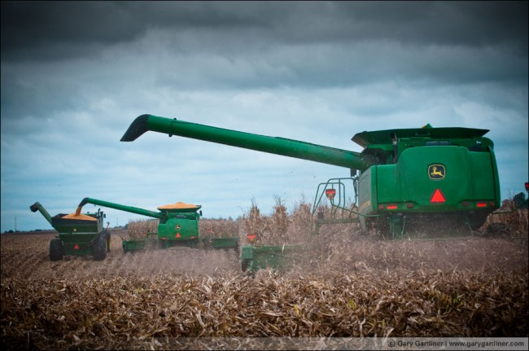
2010 Corn Hybrid Results

Slide 2
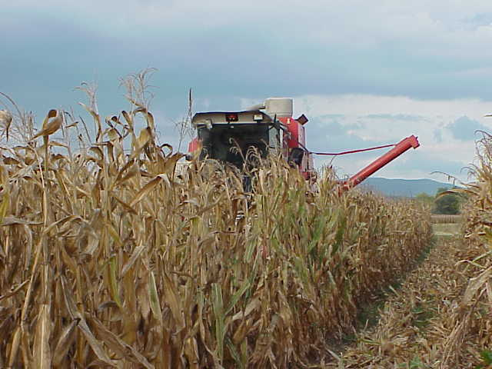
Variety Selection Considerations
Adaptation
Performance Data
  Yield & Test wt.
  Heading
  Disease resistance
  Lodging/Standability
Use Quality Seed

Slide 3
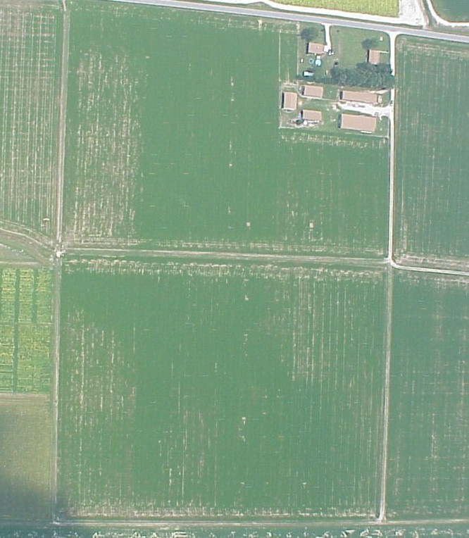
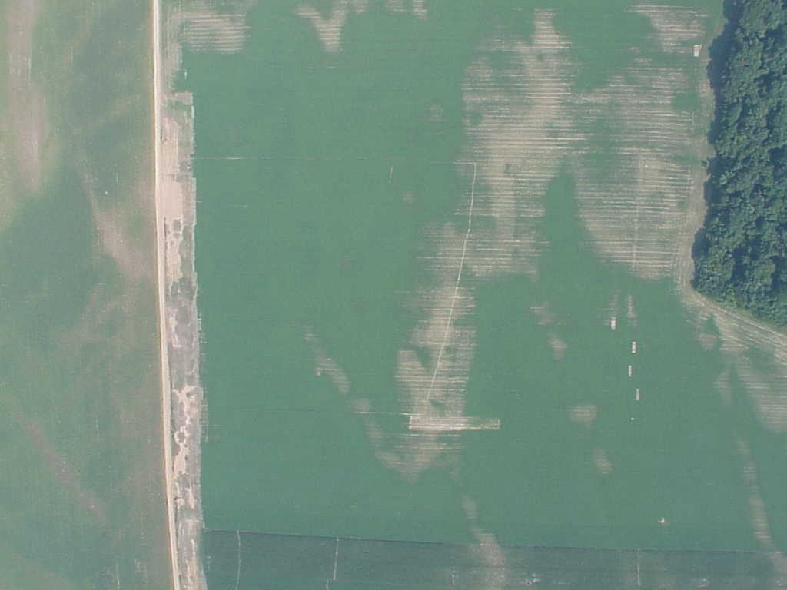
Split-field Comparison
Variety A
Variety A
Variety B
Variety B

Slide 4
Strip Plots (un-replicated)
1
2
3
4
5
6
7
8
9
10
11
12
13
14
15
16
17
18

Slide 5
Strip Plots (un-replicated)
With Check Plots
C
1
2
3
4
5
C
6
7
8
9
10
C
11
12
13
14
15
C

Slide 6
Head-to-Head Comparisons (replicated)
1
2
2
1
1
2
2
1
1
2
2
1
1
2
2
1
1
2

Slide 7
Official Variety Tests
Ideal
High Variability
(between reps)
Rep 1 Rep 2 Rep 3

Slide 8
Average Yield by MG, 2010 VA OVT

Slide 9
<108 day RM
 |  |  |  | DTM per |  | Mt Holly | Mt Holly |  | Blacks- | Shenan-
Brand/Company | Hybrid | IST¹ | GT² | Co.³ | Holland | Dryland | Irrigated | Orange | burg | doah | Mean
<108 Days Relative Maturity
RPM | RPM 633HXR | C | CB/GU/GY | 107 | 108 | 103 | 101 | 128 | 117 | 114 | 112
DEKALB | DKC57-50(VT3) | PL | CB/GY/RW | 107 | --- | 122 | 102 | --- | --- | 101 | 108
Mid-Atlantic Seeds | MA5055GT3 | PL | CB/GU/GY/RW | 101 | --- | 110 | 98 | 117 | --- | 93 | 104
Mid-Atlantic Seeds | MA5001GT3 | PL | CB/GU/GY/RW | 101 | --- | 97 | 89 | 134 | --- | 94 | 104
Mid-Atlantic Seeds | MA5044GT3 | PL | CB/GU/GY/RW | 101 | --- | 129 | 88 | 109 | --- | 85 | 103
Mid-Atlantic Seeds | MA8010VT3 | PL | CB/GY/RW | 101 | --- | 107 | 89 | 115 | --- | 99 | 102
AUGUSTA | A5457 | C |  | 107 | 100 | 97 | 99 | 125 | 101 | 93 | 102
AUGUSTA | A2852GTCBLL | C | CB/GU/GY | 102 | 99 | 98 | 104 | --- | --- | --- | 100
AUGUSTA | A2752GT3 | C | CB/GY/GU/RW | 102 | 94 | 106 | 94 | --- | --- | --- | 98
DEKALB | DKC52-59(VT3) | PL | CB/GY/RW | 102 | --- | 106 | 96 | --- | --- | 91 | 98
DEKALB | DKC54-16(VT3) | PL | CB/GY/RW | 104 | --- | 96 | 105 | --- | --- | 91 | 97
Hubner Seed | H5222VT3 | PL | CB/GY/RW | 101 | 99 | 93 | 91 | 120 | 92 | 86 | 97
Hubner Seed | H6110GENSS | PL | CB/EW/GU/GY/RW | 98 | 88 | 102 | 100 | 109 | 86 | 86 | 95
AUGUSTA | A2847LL | C | GU | 97 | 89 | 109 | 84 | --- | --- | --- | 94
Mid-Atlantic Seeds | MA8009VT3 | PL | CB/GY/RW | 100 | --- | 84 | 93 | 121 | --- | 78 | 94
AUGUSTA | A2854HX | PL | CB/GU | 104 | 91 | 97 | 93 | --- | --- | --- | 93
T.A. Seeds | TA525-13V | PL | CB/GY/RW | 102 | 89 | 71 | 99 | 113 | 87 | --- | 92
AUGUSTA | A2857 | C |  | 105 | 96 | 81 | 96 | --- | --- | --- | 91
AUGUSTA | A2855GT3 | C | CB/GY/GU/RW | 105 | 88 | 106 | 76 | --- | --- | --- | 90
AUGUSTA | A2850LL | C | GU | 100 | 98 | 94 | 73 | --- | --- | --- | 88
AUGUSTA | A2851LL | C | GU | 101 | 91 | 85 | 77 | --- | --- | --- | 84

Slide 10
<108 day RM
RPM 633HXR
DKC57-50(VT3)
Hubner 6110GENSS
Notes:
The labeled hybrids produced >100% relative yield at both the Mt Holly dryland and irrigated sites.
This is the only place where we could compare stability of performance across relatively low (90 bu) and high (200 by) yields.
RPM 633, 107 day RM, Bt-LL-RR
DKC 57-50, 107 day RM, triple stack (RR)
Hubner 6110, 98 day RM (moisture similar to other 104 day RM hybrids in 2010), genuity smart stax ! Was only 95% rel yld over all locations
Hubner6100 GENSS, SS 538 VT3 and Pioneer 35F40 were tops in the Eastern Virginia ON-Farm strip results

Slide 11
108-111 day RM
 |  |  |  | DTM per |  | Mt Holly | Mt Holly |  | Blacks- | Shenan-
Brand/Company | Hybrid | IST¹ | GT² | Co.³ | Holland | Dryland | Irrigated | Orange | burg | doah | Mean
108-111 Days Relative Maturity
Seed Consultants | SCS 11HR21 | C |  | 111 | --- | 117 | 117 | 96 | 96 | 110 | 107
DEKALB | DKC61-35(GENVT3P) | A | CB/EW/GY/RW | 111 | --- | 116 | 103 | --- | --- | 101 | 107
NK Brand | N68B-3000GT Brand | C | CB/GU/GY/RW | 110 | 94 | 118 | 106 | --- | --- | --- | 106
AUGUSTA | A5461GTCBLL | C | CB/GU/GY | 111 | 108 | 99 | 117 | 75 | 115 | 121 | 106
Hubner Seed | H5505VT3P | PL | CB/EW/GY/RW | 111 | 108 | 119 | 102 | 101 | 96 | 99 | 104
Mid-Atlantic Seeds | MA8096VT3 | PL | CB/GY/RW | 109 | --- | 94 | 102 | 116 | --- | 102 | 103
ChannelBio | 211-99VT3P | A | CB/EW/GY/RW | 111 | 101 | 114 | 103 | 90 | --- | 107 | 103
ChannelBio | 210-61VT3 | PL | CB/GY/RW | 110 | 96 | 106 | 104 | 110 | --- | 98 | 103
NK Brand | N72Q-3000GT Brand | C | CB/GU/GY/RW | 110 | --- | 95 | 106 | --- | --- | 103 | 102
AUGUSTA | A5460GT3 | C | CB/GU/GY/RW | 110 | 90 | 113 | 108 | 100 | --- | 95 | 101
DEKALB | DKC58-83(GENVT3P) | A | CB/EW/GY/RW | 108 | --- | 118 | 94 | --- | --- | 92 | 101
T.A. Seeds | TA657-13VP | PL | CB/EW/GY/RW | 111 | 110 | 93 | 112 | 81 | 105 | 101 | 100
AUGUSTA | A5337EVT3 | C | CB/GY/RW | 111 | 119 | 110 | 108 | 56 | 105 | 101 | 100
Hubner Seed | H5451VT3 | PL | CB/GY/RW | 109 | 89 | 127 | 93 | 97 | 98 | 91 | 99
Dyna-Gro | 57V40 | PL | CB/GY/RW | 111 | 105 | 103 | 101 | 87 | --- | --- | 99
AUGUSTA | A0606CBLL | C | CB/GU | 111 | --- | 97 | 107 | 73 98 77 | 103 | 114 | 99
Seed Consultants | SC 10AQ91A | C | CB/GU/GY/RW | 108 | --- | 103 | 100 |  | 94 | 99 | 99
Seed Consultants | SC 11AQ07 | C | CB/GU/GY/RW | 109 | --- | 119 | 92 |  | 100 | 100 | 97
AUGUSTA | A5558VT3 | C | CB/GY/RW | 108 | 91 | 102 | 95 | 98 | --- | --- | 96
RPM | RPM 725HRQ | C | CB/GU/GY/RW | 111 | 82 | 90 | 112 | 68 | 107 | 114 | 96
Seed Consultants | SCS 11HQ00 | C | CB/GU/GY/RW | 109 | --- | 113 | 96 | 83 | 95 | 90 | 96
Mid-Atlantic Seeds | MA8088VT3 | PL | CB/GY/RW | 108 | --- | 96 | 93 | 101 | --- | 84 | 94
Doeblers | 679GRQ | C | CB/GU/GY/RW | 109 | 97 | 103 | 92 | 93 | 77 | 95 | 93
Seed Consultants | SCS 1081 | C | CB/GU/GY/RW | 109 | --- | 91 | 94 | 68 | 93 | 105 | 90
Hubner Seed | H5555VT3 | PL | CB/GY/RW | 111 | 90 | 93 | 95 | 71 | 97 | 94 | 90
Doeblers | 721XY | PL |  | 111 | 90 | 79 | 98 | 64 | 103 | 105 | 90
Mid-Atlantic Seeds | MA8109VT3Pro | PL | CB/EW/GY/RW | 110 | --- | 80 | 96 | 76 | --- | 104 | 89
T.A. Seeds | TA590-00 | PL |  | 109 | 93 | 103 | 79 | 76 | 77 | --- | 85

Slide 12
108-111 day RM
Seed Consultants | SCS 11HR21
DEKALB | DKC61-35(GENVT3P)
NK Brand | N68B-3000GT Brand
Hubner Seed | H5505VT3P
ChannelBio | 211-99VT3P
ChannelBio | 210-61VT3
AUGUSTA | A5460GT3
AUGUSTA | A5337EVT3
Dyna-Gro | 57V40
Seed Consultants | SC 10AQ91A
Notes:
DTM per
Co.³
Seed Consultants SCS 11HR21 111
DEKALB DKC61-35(GENVT3P) 111
NK Brand N68B-3000GT Brand 110
Hubner Seed H5505VT3P 111
ChannelBio 211-99VT3P 111
ChannelBio 210-61VT3 110
AUGUSTA A5460GT3 110
AUGUSTA A5337EVT3 111
Dyna-Gro 57V40 111
Seed Consultants SC 10AQ91A 108
IN the eastern VA on-farm plots, best hybrids were: Pioneer 1184HR, SC 11AGT30 (112 RM), Hubner 5505, and SS 684 VT3

Slide 13
112-115 day RM
 |  |  |  | DTM per |  | Mt Holly | Mt Holly |  | Blacks- | Shenan-
Brand/Company | Hybrid | IST¹ | GT² | Co.³ | Holland | Dryland | Irrigated | Orange | burg | doah | Mean
112-115 Days Relative Maturity
Hubner Seed | H5707VT3 | PL | CB/GY/RW | 114 | 102 | 104 | 105 | 154 | 113 | 123 | 117
DEKALB | DKC63-84(VT3) | PL | CB/GY/RW | 113 | 117 | 116 | 110 | --- | --- | 113 | 114
DEKALB | DKC64-69(GENVT3P) | A | CB/EW/GY/RW | 114 | 118 | 113 | 110 | --- | --- | 114 | 114
Dyna-Gro | 57V59 | PL | CB/GY/RW | 113 | 120 | 114 | 98 | 119 | --- | --- | 113
Dyna-Gro | 57V21 | PL | CB/GY/RW | 115 | 118 | 100 | 106 | --- | --- | 123 | 112
Seed Consultants | SC 11VTT45 | C | CB/GY/RW | 114 | --- | 103 | 99 | 127 | 103 | 117 | 110
AUGUSTA | A0720CBLL | C | CB/GU | 112 | 106 | 121 | 103 | --- | --- | --- | 110
Mid-Atlantic Seeds | MA8143VT3 | PL | CB/GY/RW | 114 | --- | 101 | 107 | 121 | --- | 107 | 109
Hubner Seed | H5909VT3P | PL | CB/EW/GY/RW | 115 | 110 | 100 | 97 | 129 | 106 | 112 | 109
Hubner Seed | H5753VT3 | PL | CB/GY/RW | 112 | 96 | 103 | 110 | 133 | 102 | 108 | 109
DEKALB | DKC64-24(VT3) | PL | CB/GY/RW | 114 | 115 | 107 | 105 | --- | --- | 107 | 108
Garst | 84J30-3000GT Brand | C | CB/GU/GY/RW | 112 | --- | 110 | 105 | --- | --- | 109 | 108
Mid-Atlantic Seeds | MA8129VT3Pro | PL | CB/EW/GY/RW | 112 | --- | 92 | 113 | 119 | --- | 107 | 108
Seed Consultants | SC 11AGT30 | C | CB/GU/GY | 112 | --- | 114 | 97 | 103 | 109 | 114 | 107
DEKALB | DKC62-97(GENVT3P) | A | CB/EW/GY/RW | 112 | --- | 112 | 108 | --- | --- | 100 | 107
T.A. Seeds | TA778-13V | PL | CB/GY/RW | 115 | 104 | 109 | 96 | 115 | 101 | 113 | 106
DEKALB | DKC62-54(VT3) | PL | CB/GY/RW | 112 | 105 | 111 | 107 | --- | --- | 102 | 106
Seed Consultants | SCS 11HQ39 | C | CB/GU/GY/RW | 113 | --- | 116 | 99 | 128 | 97 | 92 | 106
Dyna-Gro | D52Q90 | PL | CB/GY/RW | 112 | 104 | 113 | 95 | 106 | --- | --- | 105
Seed Consultants | SCS 11HQ38 | C | CB/GU/GY/RW | 112 | --- | 85 | 104 | 115 | 108 | 106 | 103
AUGUSTA | A5462GT3 | C | CB/GU/GY/RW | 112 | 97 | 73 | 117 | 113 | 109 | 105 | 103
T.A. Seeds | TA717-20 | PL | CB/GU/GY/RW | 114 | 93 | 100 | 99 | 117 | 104 | 99 | 102
Mid-Atlantic Seeds | MA5158 | PL |  | 115 | --- | 92 | 102 | 109 | --- | 104 | 102
NK Brand | N77H-3000GT Brand | C | CB/GU/GY/RW | 113 | --- | 100 | 95 | --- | --- | 107 | 101
T.A. Seeds | TA765-00 | PL |  | 115 | 103 | 93 | 106 | 91 | 109 | --- | 100
ChannelBio | 214-14VT3P | A | CB/EW/GY/RW | 114 | 111 | 94 | 105 | 91 | --- | 101 | 100
Mid-Atlantic Seeds | MA8131VT3Pro | PL | CB/EW/GY/RW | 113 | --- | 94 | 97 | 123 | --- | 86 | 100
AUGUSTA | A6164GT3 | C | CB/GU/GY/RW | 114 | 94 | 86 | 100 | 113 | 95 | 101 | 98
Seed Consultants | SCS 11RR60 | C | GY | 115 | --- | 87 | 99 | 107 | 102 | 94 | 98
Southern States | SS 749 VT3Pro | PH | CB/EW/GY/RW | 115 | 104 | 104 | 111 | 69 | --- | 97 | 97
AUGUSTA | A6365GT | C | GY | 115 | 91 | 85 | 91 | 103 | 89 | 97 | 93
AUGUSTA | A007Q | PH |  | 115 | --- | 83 | 100 | --- | 86 | --- | 90

Slide 14
112-115 day RM
Hubner Seed | H5707VT3
DEKALB | DKC63-84(VT3)
DEKALB | DKC64-69(GENVT3P)
Dyna-Gro | 57V21
AUGUSTA | A0720CBLL
Mid-Atlantic Seeds | MA8143VT3
Hubner Seed | H5753VT3
DEKALB | DKC64-24(VT3)
Garst | 84J30-3000GT Brand
DEKALB | DKC62-97(GENVT3P)
DEKALB | DKC62-54(VT3)
Southern States | SS 749 VT3Pro
Notes:
Hubner Seed H5707VT3 114
DEKALB DKC63-84(VT3) 113
DEKALB DKC64-69(GENVT3P) 114
Dyna-Gro 57V21 115
AUGUSTA A0720CBLL 112
Mid-Atlantic Seeds MA8143VT3 114
Hubner Seed H5753VT3 112
DEKALB DKC64-24(VT3) 114
Garst 84J30-3000GT Brand 112
DEKALB DKC62-97(GENVT3P) 112
DEKALB DKC62-54(VT3) 112
Southern States SS 749 VT3Pro 115
Tops in the eastern VA strip plot results: DKC 63-84, dyna gro 57v59

Slide 15
>115 day RM
 |  |  |  | DTM per |  | Mt Holly | Mt Holly |  | Blacks- | Shenan-
Brand/Company | Hybrid | IST¹ | GT² | Co.³ | Holland | Dryland | Irrigated | Orange | burg | doah | Mean
>115 Days Relative Maturity
DEKALB | DKC68-05(GENVT3P) | A | CB/EW/GY/RW | 118 | 109 | 119 | 103 | --- | --- | --- | 110
AUGUSTA | A6867CBLL | C | CB/GU | 117 | 93 | 116 | 114 | 112 | 107 | 111 | 109
ChannelBio | 216-63VT3 | PL | CB/GY/RW | 116 | 110 | --- | --- | 103 | --- | 106 | 106
Seed Consultants | SCS 11VTT79 | C | CB/GY/RW | 117 | --- | 100 | 100 | 97 | 111 | 107 | 103
DEKALB | DKC66-96(GENVT3P) | A | CB/EW/GY/RW | 116 | 106 | 97 | 104 | --- | --- | --- | 102
Southern States | SS 818RR2 | PH | GY | 118 | 109 | 83 | 108 | 117 | --- | 72 | 98
Dyna-Gro | V5683VT3 | PL | CB/GY/RW | 116 | 107 | 91 | 104 | --- | --- | 87 | 97
AUGUSTA | A6166GTCBLL | C | CB/GU/GY | 116 | 97 | 85 | 100 | 106 | 100 | 92 | 96
Mid-Atlantic Seeds | MA5160GT | PL | GY | 116 | --- | 95 | 100 | 99 | --- | 90 | 96
Seed Consultants | SCS 11HR70 | C | CB/GU/GY | 117 | --- | 71 | 101 | 93 | 102 | 102 | 94
AUGUSTA | A0602 | C |  | 119 | 95 | 90 | 91 | 75 | 92 | 89 | 89
Seed Consultants | SCS 11HR69 | C | CB/GU/GY | 116 | --- | 87 | 82 | 85 | 94 | 82 | 86
Seed Consultants | SCS 1200 | C |  | 119 | --- | 56 | 95 | 25 | 98 | 92 | 73

Slide 16
>115 day RM
DKC68-05(GENVT3P)
Notes:
DTM
AUGUSTA A6867CBLL 117
Seed Consultants SCS 11VTT79 117
DEKALB DKC68-05(GENVT3P) 118
Tops in the eastern VA test were A6867,

